Slide 1
Practical Messaging
A 101 guide to messaging
Ian Cooper
X and Hachyderm: ICooper

Slide 2
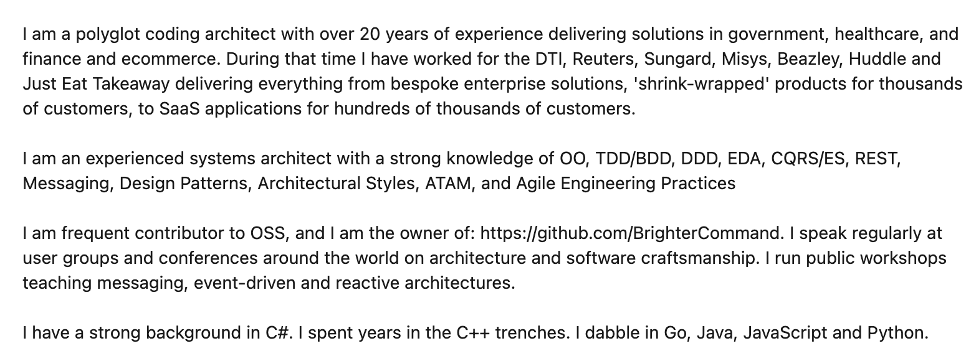
Who are you?
www.linkedin.com/in/ian-cooper-2b059b

Slide 3
Day One Messaging
Distribution
Integration Styles
Request Driven Architectures
Event Driven Architectures
Reactive Architectures
Messaging Patterns

Slide 4
Day Two Conversations
Queues and Streams
Conversation Patterns
Activity and Correlation
Repair and Clarification
Reliable Messaging
Fat and Skinny
Conversations
Reactive Architectures
Message Passing
Paper Based Flows
Flow Based Programming
Managing Async APIs
Versioning
Documentation
Observability
Next Steps

Slide 5
Day Two

Slide 6
Queues and Streams

Slide 7
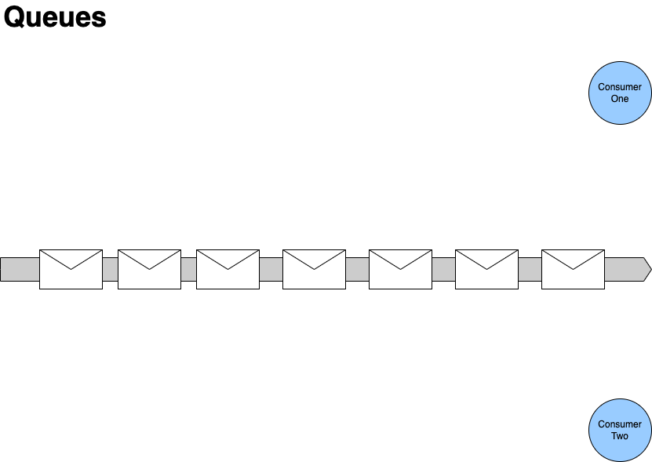

First consumer locks the next message in the queue whilst it processes it.
Second consumer locks the next available message in the queue.
Second consumer reads past any locked message in the queue.

Slide 8
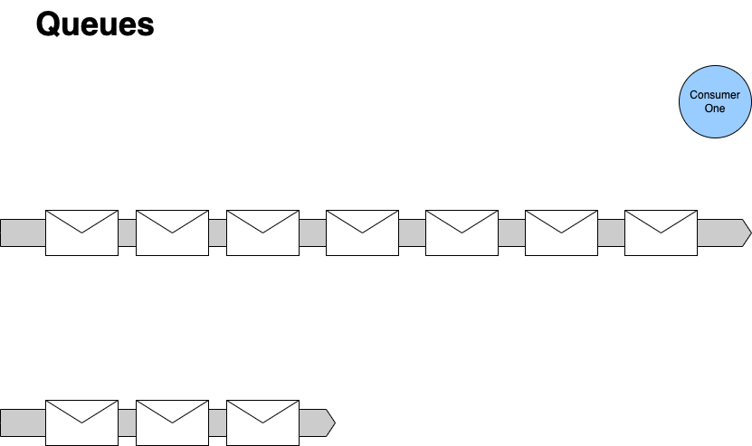



When we are done processing, we unlock it.
- Usually because we finish processing it
- May be because we fail.
If we fail, then we may decide others could succeed later, so we let it become available to lock again, often with a delay.
If we succeed, then we delete the message from the queue, no one else can now process it.
Queues contain Tasks
With queues we can think of the messages on a queue as tasks - they are a request for us to carry out an action. Once the action is done, we can delete the task.
- We don't anyone else to action it, it's already been done.
- Someone receiving a done task will have to discard it.
- If we can't action it, someone else will need to action it.
After a certain number of re-queues we may move the message to a dead-letter channel, it turns out that no one action the request within in a reasonable time frame

Slide 9
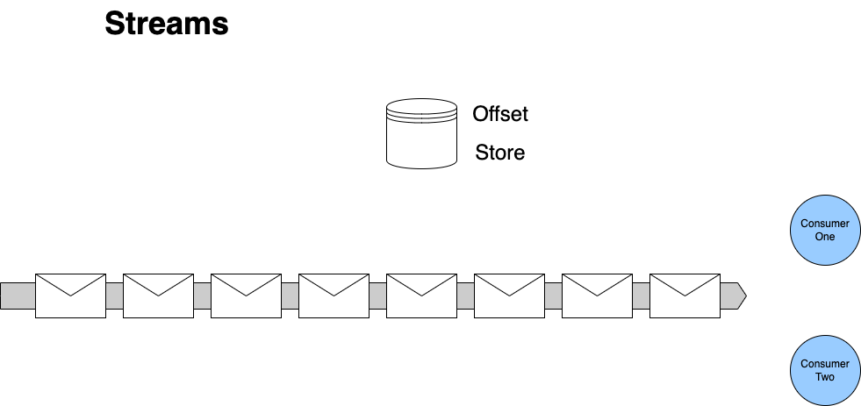
First consumer stores an offset to mark how far it has read
First consumer reads the next message in the queue and processes it.
First consumer reads the next message in the queue and processes it.
If a consumer restarts
It reads the store to determine the last message it processed
Second consumer stores an offset to mark how far it has read
Streams contain Facts
With streams we can think of the records on the stream as facts - they are records that indicate there has been a change in state.
We can view facts as an ‘inverse database’ they represent how current stat is arrived at
We can navigate offsets to calculate a position at a ‘point in time’
We don’t consume facts by reading them, they persist
Second consumer reads the next message in the queue and processes it.

Slide 10
Scaling Queues and Streams

Slide 11
First consumer locks the next message in the queue whilst it processes it.
Second consumer reads past any locked message in the queue.
Second consumer locks the next available message in the queue.
Competing Consumers
We scale consumption of a queue by adding more consumers

Slide 12
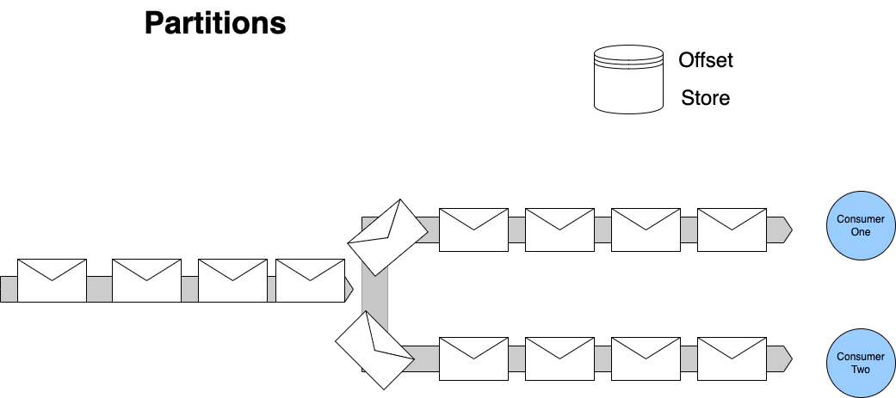
Streams
Each consumer manages offsets for their partition.
To scale out we must divide the stream up. We partition the stream to allow multiple consumers to read it.
For any set of events that must be processed sequentially - all changes to one entity for example - we use consistent hashing to push messages with the same identifier to the same partition. This allows us to scale, whilst preserving our ordering.

Slide 13
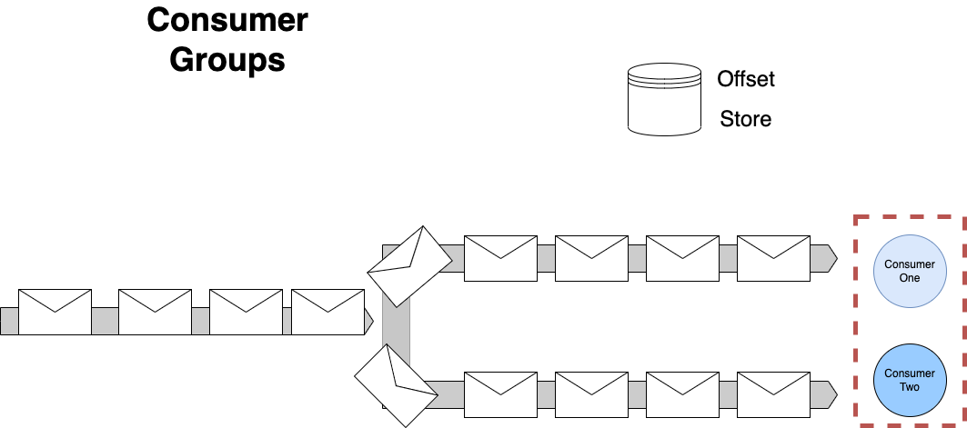
Streams
To provide availability – only one consumer in a group can read from a partition at a time – but a consumer in a group may read from more than one of the partitions owned by that group

Slide 14
Archive and Replay

Slide 15
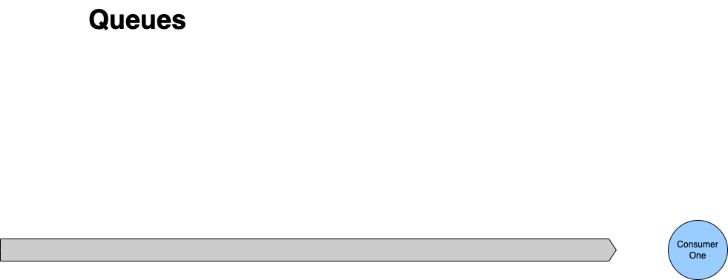

If we succeed, then we delete the message from the queue, no one else can now process it.
No Archive and Replay
With queues we delete a message once we have completed the associated action. That means we have no way to replay the request for work. Our only option is to ask the producer to resend their request.

Slide 16
We don’t delete a message, we just increment the offset.
Archive and Replay
Archive and Replay is straightforward as nothing is deleted. We simply reset the consumer’s offset to re-read the stream

Slide 17
Requeue and Delay (Backpressure)

Slide 18
When we are done processing, we unlock it.
- Usually because we finish processing it
- May be because we fail.
If we fail, then we may decide others could succeed later, so we let it become available to lock again, often with a delay.
If we succeed, then we delete the message from the queue, no one else can now process it.
Requeue and Delay (Backpressure)
A queue supports re-queue (with delay)
If the work is not done/acked, just make it available again to the next consumer
If the work could not be done because of a transient issue, delay to let is pass
After a certain number of re-queues we may move the message to a dead-letter channel, it turns out that no one action the request within in a reasonable time frame

Slide 19
We don’t delete a message, we just increment the offset.
No Requeue or DLQ
Because we do not lock items, we do not requeue items, including requeue with delay. Your strategy is:
Ignore and Continue (Load Shedding)
Retry (Backpressure)
Copy to another stream (a delay or DLQ stream)

Slide 20


 | Messaging | Discrete Event | Series Event
Queue
Stream
 | Ordering | Archive and Replay | Requeue with Delay
Queue
Stream

Slide 21

Exercise material
Introduction to Kafka
Readme
Slides

Slide 22
Conversation Patterns

Slide 23
Messaging Participants
A message has a header (metadata) and a body (data)
An application acts as either a requestor or provider
1.1 request()
:requestor
:provider
Prefer Requestor and Provider better than Producer/Consumer for conversation patterns because they indicate role.
A message is sent over a channel which is a virtual pipe i.e. topic, routing key
A channel is unidirectional (one way)
Notes:
The problem with using producer and consumer is that the consumer of the message might be the one exposing operations: i.e. receiving a command, or the producer of the API might be the one exposing operations i.e. sending a notification. By thinking instead about requestor and producer we make the role clearer => are you providing the API or using it.

Slide 24
Messaging Participants
Requestor: Registers a store and optimizes for a fast lookup on key search terms
Message indicating new store details
1.1 changedstore()
: Search
: Store Information
Provider:
Manages stores for our ecommerce site

Slide 25
In-Only (Fire and Forget)
Typically we call this fire-and-forget.
Under a In-Only pattern the requestor sends a request to the provider, but does not seek an acknowledgment of completion of the requested operation
1.1 request()
:requestor
:provider

Slide 26
In-Only (Fire and Forget)
Requestor: Has a paid for basket it wants to turn into an order
Typically fire and forget is used where we are finished with our part in a flow, and transferring control. We need no response as we are done..
1.1 place order()
:cashier
:order placement
Provider:
Raises an Order

Slide 27
Out-Only (Notification)
Under an Out-Only pattern the requestor subscribes to the provider, and an operation is triggered by receipt of a message but it does not acknowledge the message to the provider.
Typically we call this a notification.
1.1 notification()
:requestor
:provider

Slide 28
Out-Only (Publish-Subscribe)
Registers a store and optimizes for a fast lookup on key search terms
Notification indicating new store details
:Search
1.1 changedstore()
Registers all factors for determining if a store is open for business
:Store Information
Manages stores for our ecommerce site
:Availability
Out-Only is the Publish-Subscribe pattern; a producer is not aware of its consumers; the notification has loose coupling
:Pick-Up Locations
Registers where couriers may need to pick up and restrictions

Slide 29
In-Out (Request-Reaction)
Under an In-Out pattern the provider receives a request from the requestor on one channel, and returns a response from the operation triggered by that message on a separate channel.
1.1 request()
:requestor
:provider
1.2 reaction()
When using an In-Out pattern the provider sets a correlation id (conversation id) in the header of the request and the provider returns that id in the header of the response so that we can correlate replies sent over a separate channel.

Slide 30
Request-Reaction (Command-Acknowledgement)
Command: asking checkout for the operation to price a basket
Operation: Takes payment for the agreed amount and turns a basket into an order
Manages items for purchase by a customer of our ecommerce site
1.1 checkout()
:Basket
:Cashier
1.2 successfulpayment()
In-Out can support the Request-Response or Command-Acknowledgement pattern; a requestor triggers an operation on the provider and gets a response
Response: indicating the basket has been paid for
Notes:
it has behavioural (or control) coupling

Slide 31
In-Out (Query-Result)
Operation: Determines the delivery fee based on store and items in the basket
Manages items for purchase by a customer of our ecommerce site
Query asking for delivery fees for this basket
1.1 getdeliveryfees()
:Basket
:Delivery
1.2 deliverfee()
In-Out can support the Query-Result pattern; a requestor triggers a query on the provider and gets a result
Result indicating the fee for the current state of the basket
Notes:
it has behavioural (or control) coupling

Slide 32
In-Out (Subscribe-Notify)
Operation: Manages a list of subscribers
The requestor wants to subscribe to notifications
Subscription request
1.1 subscribe()
:requestor
:provider
1.2 confirm()
Query (optional) optionally we ask the requestor to confirm (note role switch!)
Start receiving Notifications
1.3 confirmed()
1.1 notification()
1.1 stop()
In-Out coupled with Out-Only can support a Subscribe-Notify pattern; a requestor requests to subscribe to a provider (start/stop)
Stop receiving Notifications
Notes:
it has behavioural (or control) coupling

Slide 33
Blocking In-Out (Request-Reply)
The requestor provides a unique Reply To channel (in the request message header/metadata) and the provider uses that channel for the response, allowing the sender to look up the suspended workflow. A correlation id is thus not required
In order to resume, we need a way to identify the suspended workflow.
1.1 request()
:requestor
:provider
1.2 reaction()
The requestor may block on the Reply To channel whilst awaiting the reply.

Slide 34
Out-In (Solicit-Response)
Under an Out-In pattern a provider solicits a response from a subscriber, and await a confirmation
1.1 solicit()
:requestor
:provider
1.2 response()
Under an Out-In pattern the subscriber confirms receipt of the provider’s solicitation

Slide 35
Out-In (Solicit-Response)
Query to see if a courier is available to receive orders for delivery; usually Delivery service will follow with notifications of available work.
Delivery service assigns delivery request to drivers
1.1 solicit()
:Courier
:Delivery
1.2 ready()
Courier offers jobs depending on location and busyness

Slide 36
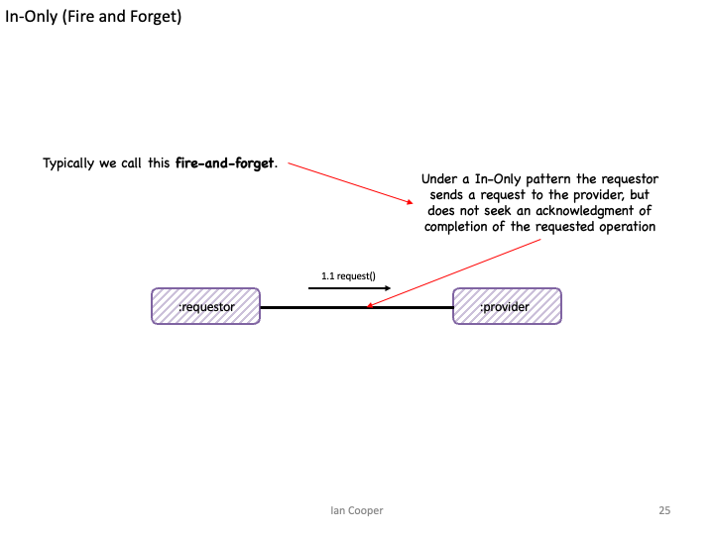
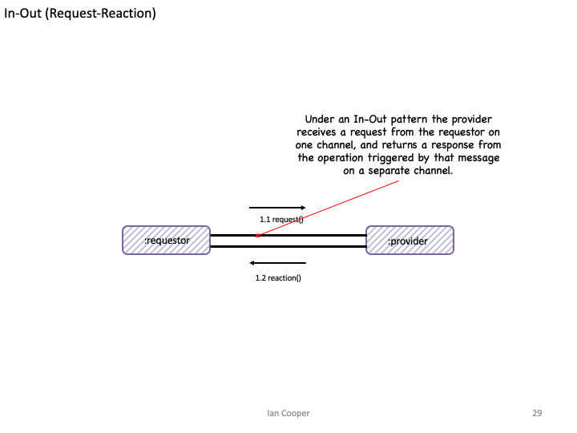
Messaging
Has Intent
Request An Answer (Query)
Transfer of Control
(Command)
Transfer of Value
Part of a Workflow
Part of a Conversation
Concerned with the Future

Slide 37
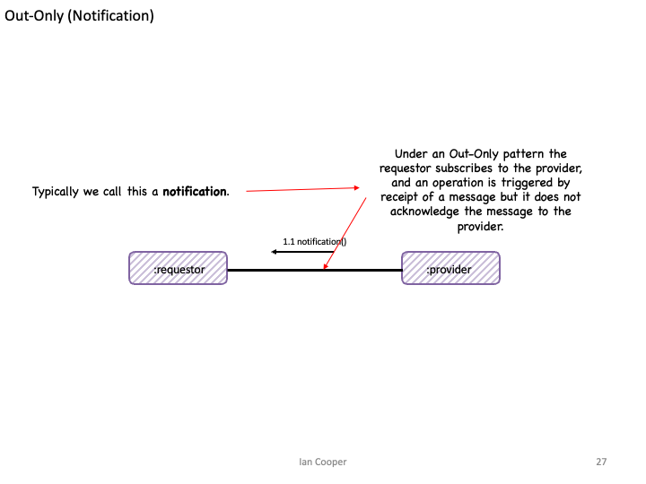
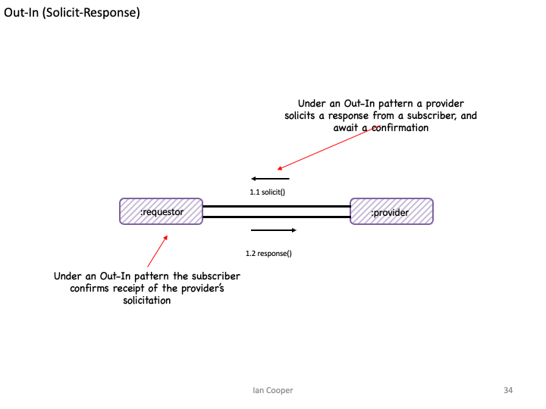
Eventing
Provides Facts
Things you Report On
No Expectations
History
Context
Concerned with the Past

Slide 38
Activity AND Correlation
How do we manage workflows in requestors and providers

Slide 39
In-Only (Fire and Forget)
1.1 request()
:requestor
:provider
Because we are fire-and-forget there is no need to maintain state to correlate with a response; we don’t expect a response

Slide 40
Out-Only (Notification)
1.1 notification()
:requestor
:provider
Because we only notify there is no need to maintain state to correlate with a response; we don’t expect an acknowledgement

Slide 41
In-Out (Request-Reaction)
Because we expect a response to our request we may need to save state which we then correlate with the request
We may resume a workflow that we suspended, whilst we were waiting for a response
1.1 request()
:requestor
:provider
1.2 reaction()

Slide 42
In-Out (Request-Reaction) Correlation Id
The requestor adds a Correlation Id (in the request message header/metadata) and the provider returns that in the response, allowing the sender to look up the suspended workflow
In order to resume, we need a way to identify the suspended workflow.
1.1 request()
:requestor
:provider
1.2 reaction()

Slide 43
In-Out (Request-Reaction) Activity
Because the flow is asynchronous, the requestor enters a waiting for response state – as it cannot complete its own operation until it gets the response. Pat Helland calls this an Activity.
The provider can remain stateless as it only needs to return a response to the requestor
:requestor
:provider
1.1 request()
Waiting for Response
1.2 reaction()
The requestor must be STATEFUL

Slide 44
In-Out (Request-Reaction) Activity
:cashier
An activity is the code that runs in response to receiving a message.
1.2*: get pricing details()
:pricer
Waiting for Response
1.3*: item price()
An activity also stores the state associated with the activity – what did we do in our last turn? It is keyed by a Correlation Id or Reply To channel.
1.4*: take payment()
:payment provider
An activity also knows the messages that is has sent and received, so it can be reconstructed.
Waiting for Response
1.5*: payment taken()

Slide 45
In-Out (Request-Reaction) Activity
:cashier
:payment provider
An activity is the code that runs in response to sending a message.
1.4*: take payment()
Waiting for Response
An activity may store state associated with the activity – but also may be stateless (Message as the Engine of State.)
1.5*: payment taken()
Each activity also knows the messages that is has sent and received, so the conversation can be reconstructed.
Waiting for Response

Slide 46
In-Out (Request-Reaction) Message As Engine of Application State
The requestor can remain stateless by including the state of the conversation within the message it sends
The provider returns the state of the conversation, adjusted for its operation results
:requestor
1.1 request()
:consumer
1.2 reaction()
The requestor does not need to be STATEFUL, as it just obtains the state of the conversation from the message
N.B. in HTTP this idea becomes HATEOAS

Slide 47
Repair and Clarification
What happens when it all goes wrong

Slide 48
Failure
Failure Scenarios
Loss of messages, out of order messages, incorrect message schema, loss of broker - a distributed system can fail in many ways.
1.1 message()
:requestor
:provider
1.2 acknowledge()
Availability is Latency
We achieve availability by temporal decoupling but this implies that we must cope with latency, even without failure.
Consistency
How can we know that a consumer received a message or processed it?

Slide 49
Failure
What happens if the checkout message is ill-formed
What happens if we can’t take payment, does it matter if that is because of
What happens if we fail to send the checkout message?
1.1 checkout()
:Basket
:Cashier
1.2 successfulpayment()
How do we handle the latency of this response?

Slide 50
Repair and Clarification
The requestor triggers an operation on the provider by sending it a message
We need to consider the possibility of a fault being triggered by the operation triggered by the message.
1.1 request()
:requestor
:provider
What guarantees does the provider make to the requestor about communicating any faults that are triggered?

Slide 51
No Fault
From the requestor’s perspective, faults are an application issue for the provider, and not its concern
1.1 request()
:requestor
:provider
Under a No Fault pattern the provider makes no attempt to communicate triggered faults from the operation to the requestor

Slide 52
No Fault
Most likely we fix consistency issues out-of-band via logs or error reports.
1.1 changedstore()
: Store Information
:Search
We make no attempt to indicate to Store Information that we cannot add a store to our search results
Notes:
This is “good enough” in many cases.

Slide 53
Message Triggers Fault (Robust In-Only)
Assumption here is that the requestor can take action on receipt of the fault; but does not normally take a response.
Under Message Triggers Fault pattern a provider propagates triggered faults from the operation back to the requestor that triggered the operation via a message
1.1 request()
:requestor
:provider
1.2 fault()
The message must have the opposite direction and go back to the requestor
Notes:
The key here is that there is no existing subsequent message to replace with a fault, but we still want to communicate faults back

Slide 54
Message Triggers Fault
If Order Placement cannot place the order due to a fault we may raise an error
1.1 place order()
:cashier
:order placement
1.2 fault()
The requestor does not need to acknowledge success, but on a fault may need to take other action such as a refund

Slide 55
Fault Replaces Message
Under the Fault Replaces Message pattern a provider propagates faults triggered by an operation by switching to a fault flow, replacing any message subsequent to the first with a fault.
1.1 request()
:requestor
:provider
1.2 fault()
1.2 reaction()
The requestor can handle the error; the error replaces the existing response
Notes:
The key to understanding this is that any message in the conversation, between these two components, after the first, may indicate a fault instead of the normal outcome

Slide 56
Fault Replaces Message (Robust In-Out)
Assumption here is that the pricer can orchestrate a new flow, such as asking for an alternate payment method, or cancel the order.
Under Fault Replaces Message pattern the payment provider would signal errors taking a card payment back to the pricer
1.14* take payment()
:pricer
:payment provider
1.5 payment error()
The message should indicate why the payment failed. This might be an issue with the payment provider but it also might be an issue like an invalid card or insufficient funds

Slide 57

In-Out-Retry
The requestor may not receive an expected response from a provider. What can it do?
The requestor can set a timeout within which to receive a response.
1.1 greet()
:requestor
:provider
1.2 greet()
1.3 acknowledge()
The requestor can choose to retry if it does not receive a response within that time window.
Because we might send a message twice, the operation on the consumer must be idempotent, or the consumer must de-duplicate already seen messages

Slide 58
Tentative Operations
The requestor may not know if the provider will be able to succeed, and might not want to proceed without knowing that
The requestor asks if the operation is possible, and reserves the resources to perform it.
The provider reserves the resource – usually with a timeout – during which time it awaits a message to commit or rollback
:requestor
1.1 reserve()
:provider
1.2 reservation()
1.3 commit()
1.4 acknowledge()
1.3 rollback()
1.4 freed()
If the requestor completes its work, it then commits to ask the provider to allocate the reserved capacity.
If the requestor fails, it then rolls back to ask the provider to free the reserved capacity.

Slide 59
Tentative Operations
We don’t want to purchase the item if the stock is not available
The basket asks the warehouse if there is stock, and if so reserves it. Fault could replace message here, if the item is out-of-stock
The warehouse reserves the stock – with a timeout (so others can purchase if we don’t) – during which time it awaits a message to commit or rollback
:basket
1.1 reserve()
:warehouse
1.2 reservation()
1.3 commit()
1.4 acknowledge()
1.3 rollback()
1.4 freed()
If the customer finishes shopping and pays for the basket before the time limit, then it commits to ask the warehouse to allocate the stock.
If the basket does not complete, then it rolls back to ask the warehouse to free the stock.

Slide 60
Reliable messaging
How do we ensure that our messaging is reliable?

Slide 61
Reliable Messaging – Outbox
Sending the message might fail, this would result in our requestor’s state being incorrect – it’s waiting for a response it will never get!
:requestor
1.4* request()
Transaction Boundary
1.2: store activity state()
: provider
Waiting for Response
1.5*: reaction()
:requestorState
1.2: store sent message()
:sentMessages
To ensure the activity state matches messages sent, we need to use transactional messaging, an Outbox.
Waiting for Response

Slide 62
Reliable Messaging – Guaranteed Delivery
:requestor
1.4* request()
Transaction Boundary
1.2: store activity state()
: provider
Waiting for Response
1.5*: reaction()
:requestorState
1.2: store sent message()
:sentMessages
Waiting for Response
1.3* request()
1.4* mark sent()
1.2* read unsent()
:sweeper
Typically we use a separate sweeper process whose job is to look for unsent messages and keep sending them until we succeed. Guaranteed Delivery.

Slide 63
Reliable Messaging – At Least Once
:requestor
1.4* request()
Transaction Boundary
1.2: store activity state()
: provider
Waiting for Response
1.5*: reaction()
:requestorState
1.2: store sent message()
:sentMessages
Waiting for Response
1.3* request()
1.4* mark sent()
1.2* read unsent()
:sweeper
The sweeper keep trying until we succeed. Because we cannot know if the message failed to send, or the middleware failed to acknowledge our send, we may resend a message that has been sent. At Least Once.

Slide 64
Reliable Messaging - Idempotency
1.1* request()
1.1* request()
: provider
:requestor
Because of At Least Once, we may receive the same message multiple times. Idempotency provides reliability when there are no side-affects from us processing that message multiple times.

Slide 65
Reliable Messaging - Inbox
1.1* request()
1.4* request()
: provider
:requestor
1.2: write message()
1.3: lookup message()
:receivedMessages
Because of At Least Once, to ensure that we have not already processed a message, we use a store seen messages, an Inbox.

Slide 66
Reliable Messaging – Once Only
1.1* request()
1.4* request()
: provider
:requestor
1.2: write message()
1.3: lookup message()
:receivedMessages
Because an Inbox filters out duplicates, we can turn At Least Once into Once Only.

Slide 67
Reliable Messaging
: payment provider
:basket
1.6* take payment()
Waiting for
Payment Response
1.7* payment taken()
Transaction Boundary
1.1: store basket state()
1.8* payment MADE()
: payments
1.1: store sent message()
:basketState
Waiting for
Provider Response
:sentMessages
1.3* request payment()
1.5: lookup message()
1.4* mark sent()
1.2* read unsent()
:sweeper
:receivedMessages

Slide 68
Fat AND Skinny

Slide 69
Fat Message
The resulting document message may be large (Claim Check can help here)
The requestor provides all external the information that the provider needs to act
1.1 request()
:requestor
:provider
With a Fat Message the requestor sends across all the external information a provider may need to perform the operation.

Slide 70
Fat Message Example
The resulting message contains delivery and pickup address, size, weights etc of the order
The requestor provides the delivery and pickup address, size, weights etc of the order
1.1 request()
:order fulfilment
:courier assignment

Slide 71
Fat Message, Transitive Dependencies
Purchase Order Message
OrderId | Customer First Name | Customer Last Name | Customer Post Code | Restaurant Name | Restaurant Post Code | Order Amount | Order items
12345 | Jo | Doe | SW17 3NJ | Pizza ‘R Us | SW17 5HK | 1038p | …
This data has a lifetime of the message i.e. the purchase order and their schema changes if the purchase order changes
This data is a transitive dependency, it has a lifetime of the Customer and their schema changes if the Customer schema changes – which may force us to change the message for Customer changes
This data is a transitive dependency, it has a lifetime of the Restaurant and their schema changes if the Restaurant schema changes – which may force us to change the message for Restaurant changes

Slide 72
Skinny Request
The requestor provides only information unique to that event, assumes provider has or can obtain other information required
The resulting notification message is normally skinny
1.1 request()
:requestor
:provider
With a Skinny Request the requestor assumes the provider has necessary external information to perform the operation.

Slide 73
Skinny Request, Example
Courier assignment needs information that is not on the order: weights, addresses. It has to source that from elsewhere
The requestor provides a notification that there is an order, but only inlines data that is unique to the order not reference data like weights or addresses
1.1 request()
:order notification
:courier assignment

Slide 74
Skinny Message, Normalized
Purchase Order Message
Customer
OrderId | Order Amount | Order items | CustomerId | RestaurantId
12345 | 1038p | …
Customer First Name | Customer Last Name | Customer Post Code
Jo | Doe | SW17 3NJ
Restaurant
We use an Id where the data does not share the lifetime of the message; we assume the requestor obtains the data out-of-band
Restaurant Name | Restaurant Post Code
Pizza ‘R Us | SW17 5HK
We need to lookup this id with other providers

Slide 75
Skinny Request via REST/RPC
On a cache miss we request the data from provider B, and store it in the cache. The cache is choosing Availability over Consistency, except on a miss.
The requestor provides only information unique to that event, assumes provider A has or can obtain information from provider B
1.1 request()
1.3 request()
:requestor
:provider A
:provider B
1.4 reply()
1.2 cache lookup()
1.5 cache write()
In CAP theorem, this is choosing Consistency over Availability as it means Provider A’s uptime is that of A & B. If B fails, A fails.
We lookup the missing data in a local cache of reference data.
We may indicate both the identity and version of the information we expect the provider to hold.
:entityState
:cacheState V1
Database

Slide 76
Skinny Request using Reference Data
Data that leaves Provider B via an API is Reference Data.
It is:
- Immutable
-Versioned
-Stale
It can be cached locally to provider A to prevent the need for frequent lookups
The requestor provides only information unique to that event, assumes provider A has or can obtain information from provider B
1.1 request()
:requestor
:provider A
:provider B
1.2 cache looup()
With a Skinny Request the requestor assumes provider A B has a local cache of data from provider B that it can use to look up identifiers in the Skinny Request.
:entityState
:cacheState V1
Database

Slide 77
Skinny Request, Reference Data via ECST (Event Carried State Transfer)
The downstream provider subscribes to these notifications and writes these to the local cache.
In CAP Theorem we choose Availability over Consistency – we choose to accept stale data over accepting the risk of failure due to a Partition.
The requestor provides only information unique to that event, assumes provider A has or can obtain information from provider B
1.3 request()
:requestor
:provider A
:provider B
1.1 notification()
1.4 cache looup()
1.2 cache write()
The upstream provider raises a notification when the state of entities its own changes – out-only or pub-sub
We lookup the missing data in a local cache of reference data.
We may indicate both the identity and version of the information we expect the provider to hold.
:entityState
:cacheState V1
Database

Slide 78
Skinny Request using Reference Data
Order Fulfilment does not include address details for the restaurant for pickup, instead we assume that courier assignment has obtained it from restaurant information
1.1 request()
:order fulfilment
:courier Assignment
:restaurant Information
1.2 cache looup()
We lookup the restaurant in the local cache by id and version.
If we have the restaurant, but not the version, we can apply backpressure and retry the order after a delay
::couriers
:restaurantCache V1
Database

Slide 79
Domain, Summary, Ordering

Slide 80
Domain Event
The resulting message is usually a past participle named after the command that caused the change i.e. BasketItemRemoved, BasketItemAdded
An approach to Pub-Sub where the provider communicates granular state changes to its requestors
1.1 event()
:requestor
:provider
With a Domain Event the provider cannot use a DataType Channel as the domain events for the observable must be ordered on the same channel, and have a different schema.
This puts an additional burden on the requestor to multiplex handling the event

Slide 81
Summary Event
The resulting message is versioned and contains metadata describing the cause(s) of any changes. It is usually named after the observable in the pub-sub i.e. BasketChanged
An approach to Pub-Sub where the provider communicates a summary of state changes to its requestors
1.1 summary()
:requestor
:provider
With a Summary Event the provider can uses a DataType Channel as there is just one schema used to communicate a snapshot of the observable.

Slide 82
If Later, Stream
Reads record. Discards v2 of 12345 as is “earlier” than V3 which was already applied
Reads record. Handles v1 of 12345
98765: v2
12345: v2
98765: v1
12345: v3
12345: v1
:producer
:consumer
Reads record. Handles v3 of 12345. Is “later” than V1 so is applied
If Later allows us to use a versioned Summary Event to ignore ordering errors. Even on a stream, a non-blocking retry or guaranteed delivery via an outbox may result in out-of-order messages. We can also shed load
We cannot use If Later with a Domain Event, as they all must be applied. We can only use a blocking retry with a Domain Event and cannot shed load.
Notes:
An easier option is to publish not deltas but complete new versions of the upstream change, that can be applied to replace everything downstream. We can then apply the rule of ‘write if later’ in other words if we have v0, we can write v2 even if we do not see v1 because v2 is later and either overwrites or include v1 changes. We can then safely discard v1 changes.

Slide 83
If Later, Queue
Locks message. Expects v1 of 12345
:consumer
98765: v2
12345: v3
98765: v1
12345: v2
12345: v1
:producer
Read Past
Locks message. Writes v2 of 12345
:consumer
If later allows message to processed be out-of-order with a queue and competing consumers. A queue normally processes messages, and not events, so this only applied where we are using a queue.
If a message must be ordered, such as a series of commands, we must use requeue with delay, or a sequencer to re-order.
Notes:
An easier option is to publish not deltas but complete new versions of the upstream change, that can be applied to replace everything downstream. We can then apply the rule of ‘write if later’ in other words if we have v0, we can write v2 even if we do not see v1 because v2 is later and either overwrites or include v1 changes. We can then safely discard v1 changes.

Slide 84
Public and Private Providers
The resulting message is versioned and contains metadata describing the cause(s) of any changes.
1.1 event()
:provider
1.3 summary()
:requestor
:provider
:provider
1.1 event()
An approach to Pub-Sub where a public provider communicates with collaborators in other domains via a summary event of domain events from private providers

Slide 85
Conversations

Slide 86
Conversations
Services are Processes
An ordering of activities with a beginning and end: it has inputs and outputs (outcome)
Lack of Distributed Transactions
Whilst 2PC is possible it is rarely used, how do we create an atomic workflow?
1.2 validate basket()
1.3 price basket()
1.1 check basket()
:Validate
:Basket
:Checkout
:Price
1.4 confirm order()
1.4 checked out basket()
Command and Control
Who owns the process? Who informs us about its state? Who knows what step is next?
Coupling
Are we just coupled to data? Or are we coupled to behaviour?
Notes:
A conversation is a series of paired interactions between participants over time to achieve an outcome.
A conversation occurs between two or more participants.
In each interaction, a participant may have the role of a requestor – making a request of another participant - or a provider – satisfying a request for another participant.
Participants take turns and may switch roles, sometimes acting as a requestor and at other times as a provider during a conversation.
Within a conversation each interaction relates to a previous interaction in the same conversation.
Typically we use a correlation identifier for interactions and a conversation id for the whole (which may be natural such as order id).

Slide 87
Turn Taking
Turn-taking consists of a set of in-out pairs
:requestor
:provider
1.1 request ()
1.2 response()
1.3 request()
1.4 response()
As each participant takes its turn, it takes control of the flow
Notes:
In human communication, participants take turns speaking and listening. Each participant has an opportunity to express their thoughts, ideas, or opinions while others listen. This idea is known as turn-taking
In software, one process initiates a request by sending a message to another process, which acts as the provider.
The provider processes the request asynchronously and provides a reply or response to the requestor.
The dialogue style results in choreographed interactions among processes. Processes engage in a decentralized dialogue, exchanging messages to accomplish a specific task or workflow. Each process communicates its part of the process, triggers actions in other processes, and responds to messages received.
Each process takes its turn to send a message, and other processes, acting as listeners, receive and process those messages in a sequential manner.
Turn-taking thus ensures causality is respected in a flow.

Slide 88
Turn Taking
Activity (Internal State)
:requestor
:provider
1.1 request ()
1.2 response()
1.3 request()
1.4 response()
Conversation State

Slide 89
Turn Taking
Orchestration: turn taking implies causality, and by implication the requestor’s activity orchestrates the conversation with the provider.
:requestor
:provider
1.1 request ()
1.2 response()
1.3 request()
1.4 response()
Smart Endpoints, Dumb Pipes: we don’t need a process manager/saga, as we can use turn-taking instead

Slide 90
Turn Taking
Choreography
:payment
:basket
1.1 reserve stock()
:warehouse
1.2 reserved stock()
1.3 purchase basket()
1.5 confirm purchase()
1.4 confirm purchase()
1.6 allocate stock()
Orchestration

Slide 91
Routing Slip
The requestor can choose the steps in the Routing Slip, and thus the flow. The point of the Routing Slip though is that the steps do not then make routing choices, but stick to the planned route.
The request is a Routing Slip, which contains the steps of the workflow. Normally these are the (topics) that the message should be forwarded to and an indicator a step is complete
:provider
1.1 request()
:requestor
1.2 request()
Process Request
:provider
1.2 request()
Routing Slip
Route to next recipient
:provider
Steps[1..n]
getNextStep(): String

Slide 92
Routing Slip
Orchestration
:provider
1.1 request()
:requestor
1.2 request()
Process Request
:provider
1.2 request()
Route to next recipient
:provider

Slide 93
Process Manager (Saga)
The requestor provides the delivery and pickup address, size, weights etc of the order
1.3 request()
:requestor
:provider
1.4 reaction()
1.5 request()
:provider
1.6 reaction()
1.7 request()
:provider
1.8 reaction()
1.2 read()
1.1 write()
:workflowStore

Slide 94
Process Manager (Saga)
Orchestration
1.3 request()
:requestor
:provider
1.4 reaction()
1.5 request()
:provider
1.6 reaction()
1.7 request()
:provider
1.8 reaction()
1.2 read()
1.1 write()
:workflowStore

Slide 95
Turn Taking | Routing Slip | Process Manager (Saga)
Complex Flow | Simple Flow | Complex Flow
Rigid Flow | Dynamic Flow | Dynamic Flow
No central point of failure | No central point of failure | Central point of failure
Distributed | Distributed | Hub-and-Spoke
No central administration or reporting | Central administration but not reporting | Central Administration and Reporting

Slide 96
Exercise material
Conversations
Readme
Slides

Slide 97
Reactive Architectures

Slide 98
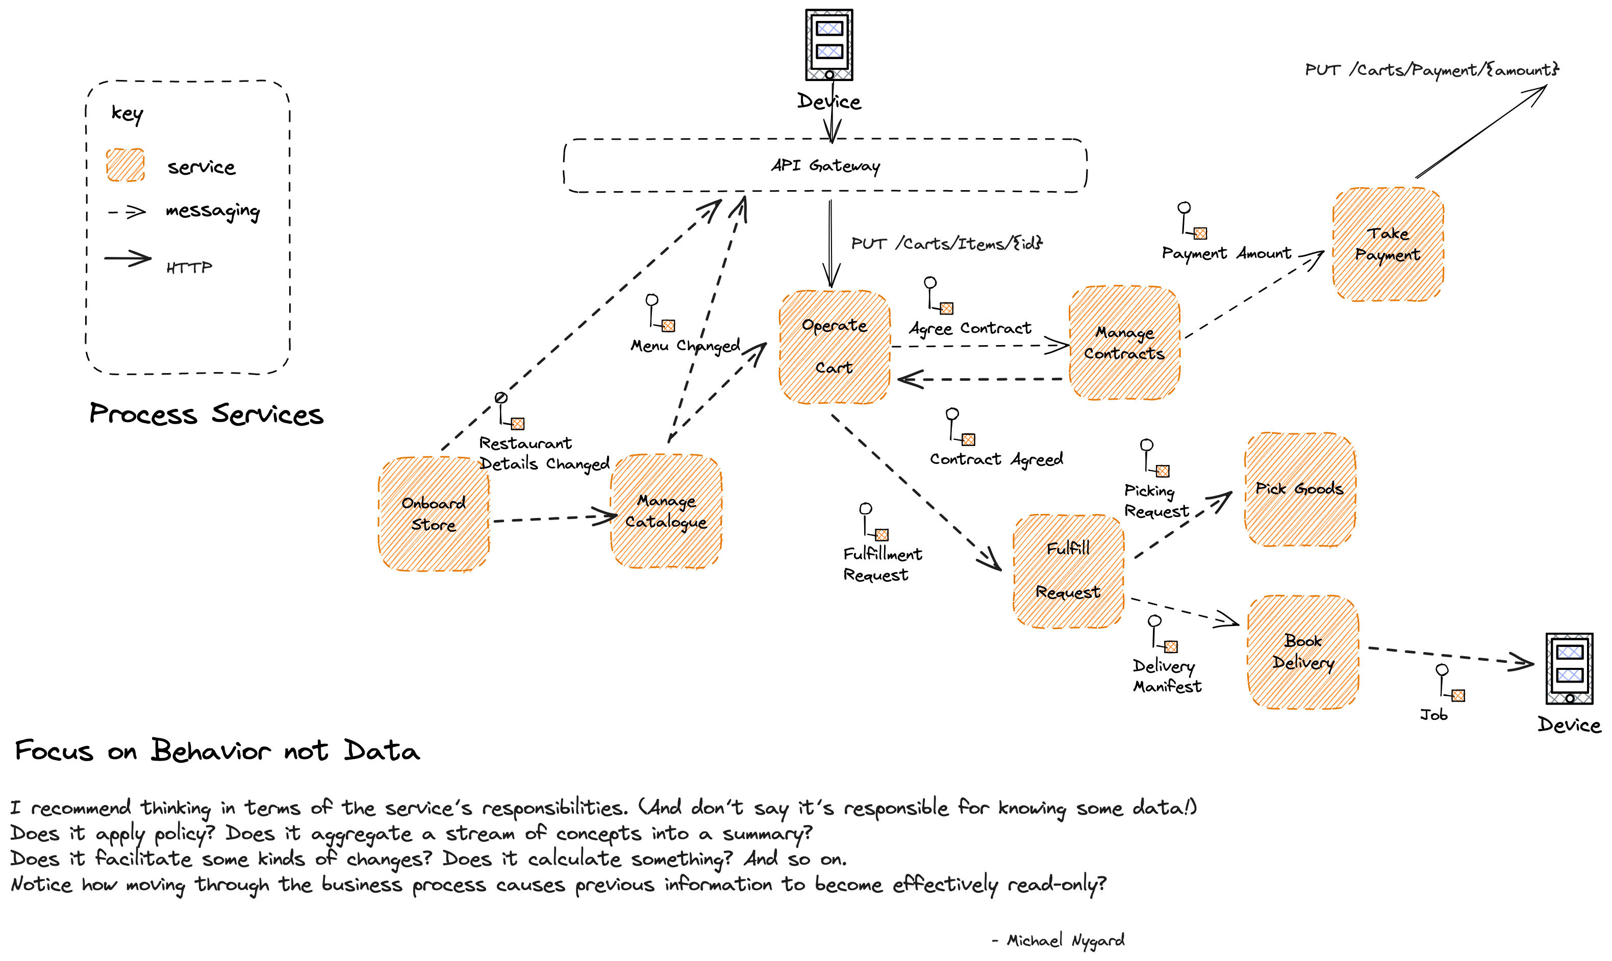

Slide 99
Paper Workflows
“My life looked good on paper - where, in fact, almost all of it was being lived.” - Martin Amis

Slide 100
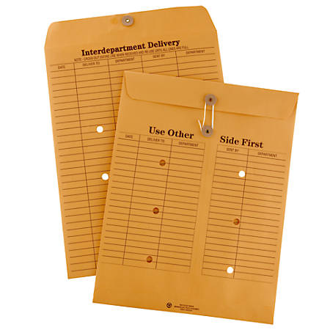

Messaging/Discrete Event
Series Event (Document)
Discrete, Immediately Actioned
Series, Supports Action
Skinny
Fat

Slide 101

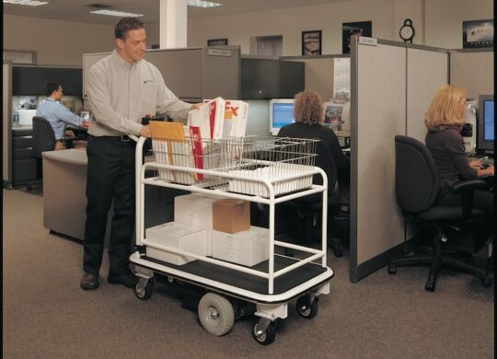

Slide 102
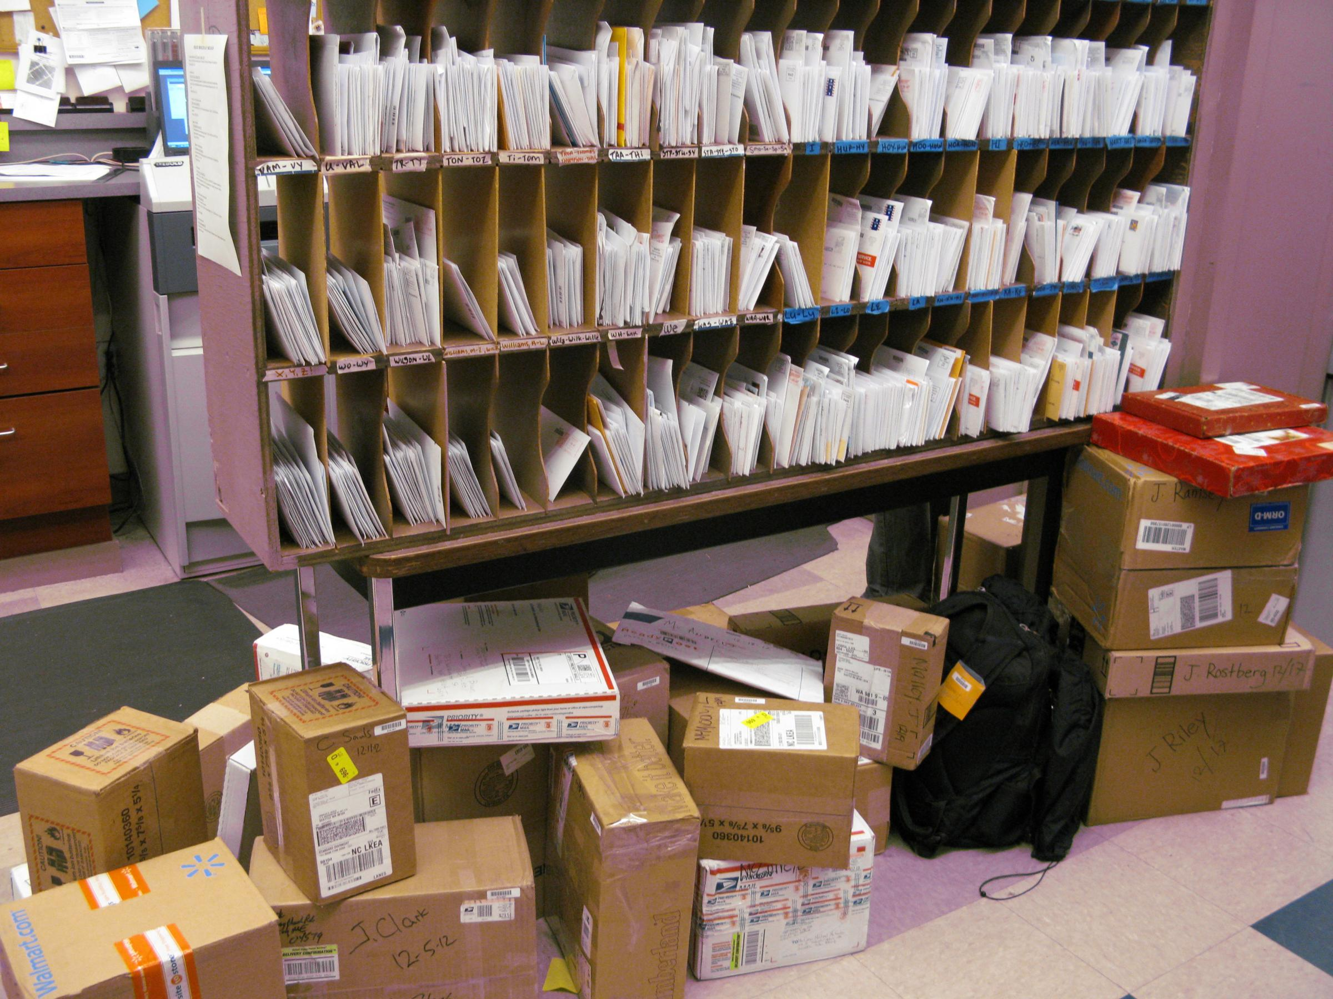
Notes:
When I worked in a mail room, this was called ‘the frame’ and it was how we sorted mail by floor, that was then delivered by a worker with a cart. In essence this is what a broker does. Creates channels, that you send messages to that are delivered to subscribers.

Slide 103
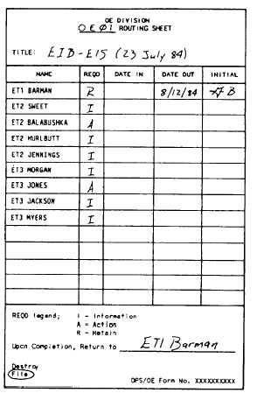

Slide 104
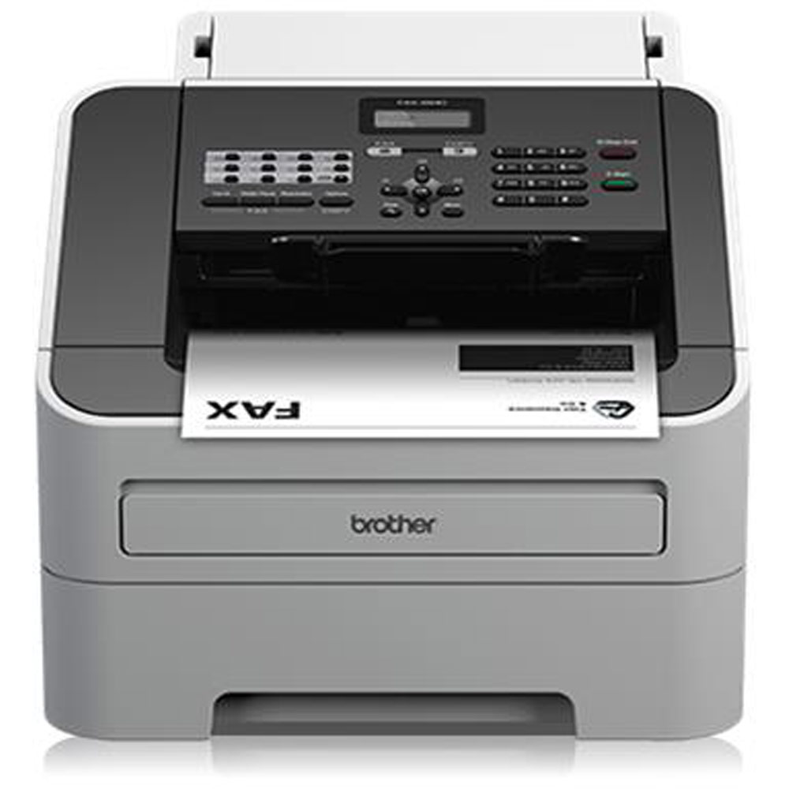

Slide 105
What is a microservice?
SOA is focused on business processes. These processes are performed in different steps (also called activities or tasks) on different systems. The primary goal of a service is to represent a “natural” step of business functionality. That is, according to the domain for which it’s provided, a service should represent a self-contained functionality that corresponds to a real-world business activity.
Josuttis, Nicolai M.. SOA in Practice: The Art of Distributed System Design . O'Reilly Media. Kindle Edition.
Notes:
Whilst this is SOA advice, we are taking the view that microservices are just SOA 3.0, and as such, most of the best practice still applies
The key here is to understand that we want service alignment with a business process or activity. Whilst services offer us benefits such as fault-tolerance through isolation, that is not the thrust of this workstream. Instead this workstream is looking at how microservices improve our productivity, when we get alignment between a service and a business process.
We amplify this point in the next slide, which talks about the entity service anti-pattern

Slide 106
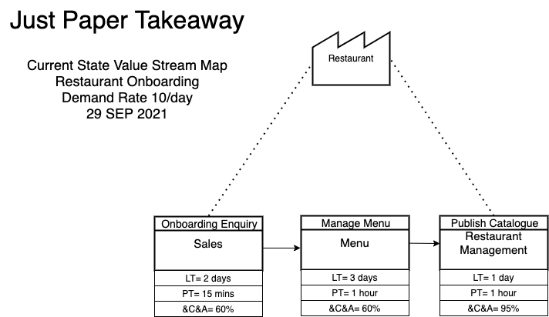

Slide 107
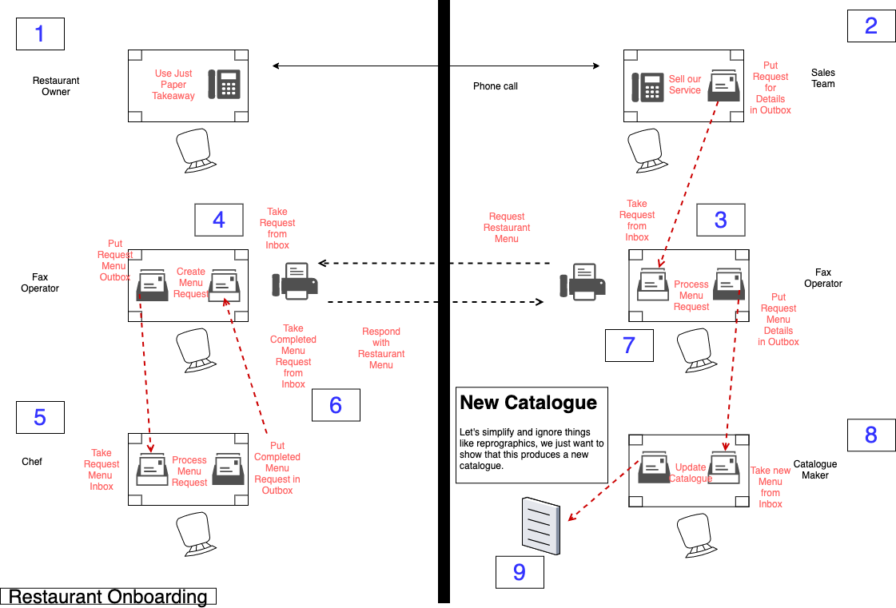

Slide 108
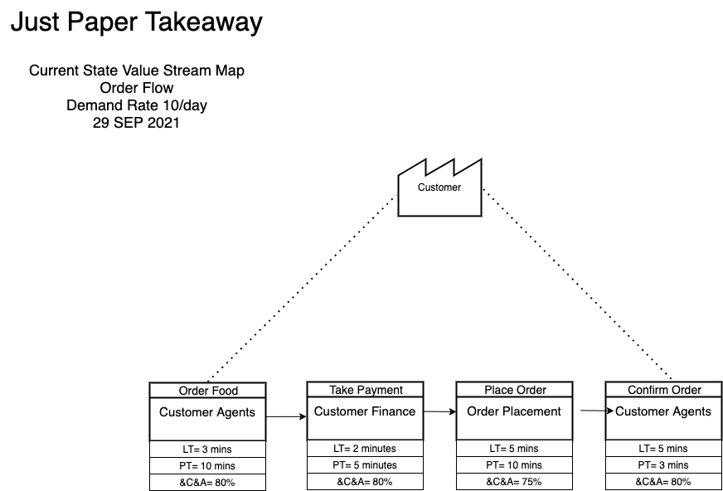

Slide 109
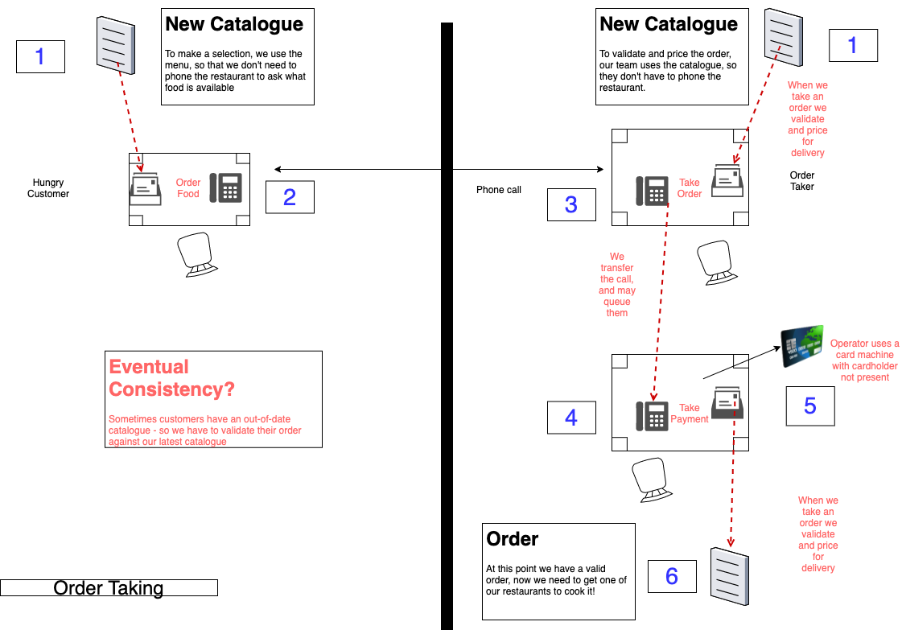

Slide 110

Order Wheel
Notes:
In a restaurant an order wheel is a piece of equipment used to track customer orders. It is used to facilitate a process whereby a new order is clipped onto a wheel which is then turned clockwise from the server or "waitress" side of the restaurant around to the kitchen or "cook" side. Orders are made in sequence and turned further back around to the server as completed.

Slide 111
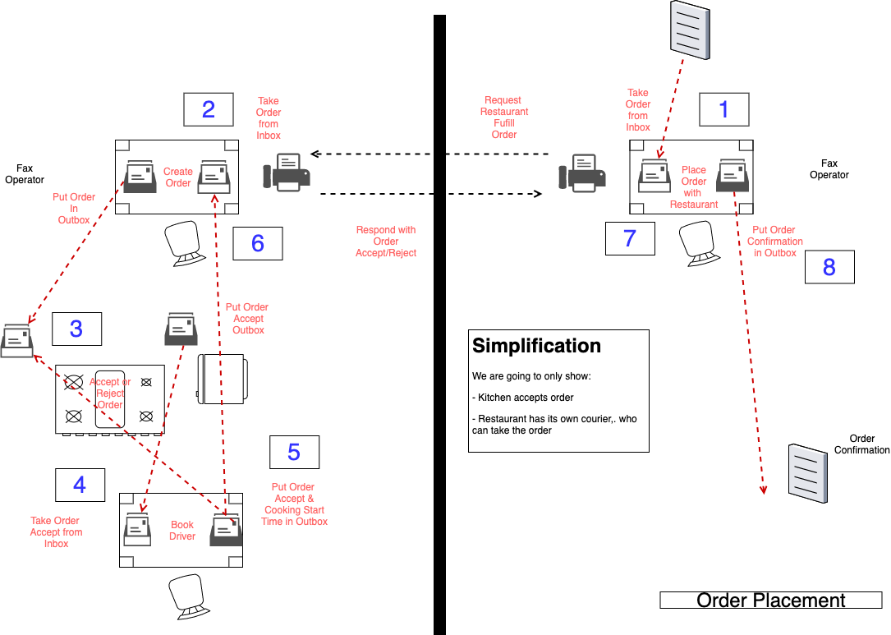

Slide 112
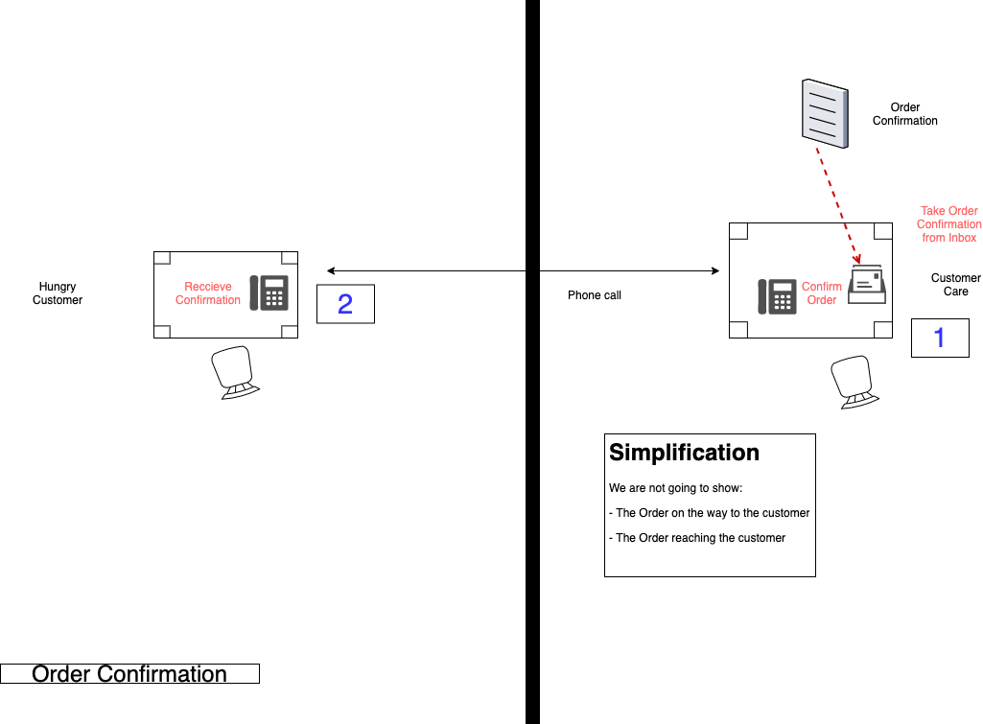

Slide 114
Compensation

Slide 115
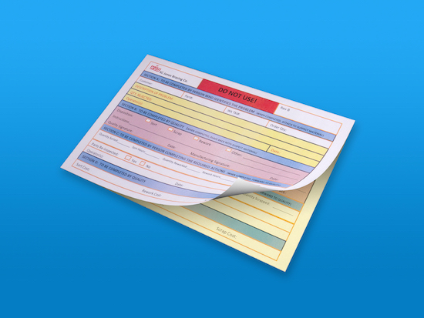
Notes:
This is a carbon copy memo – when you write on it, the pressure creates a copy in the carbon paper underneath, it was used to ensure that you had a copy of any message that you sent. You could also look through the message history on a file to understand the current state of a file.

Slide 116
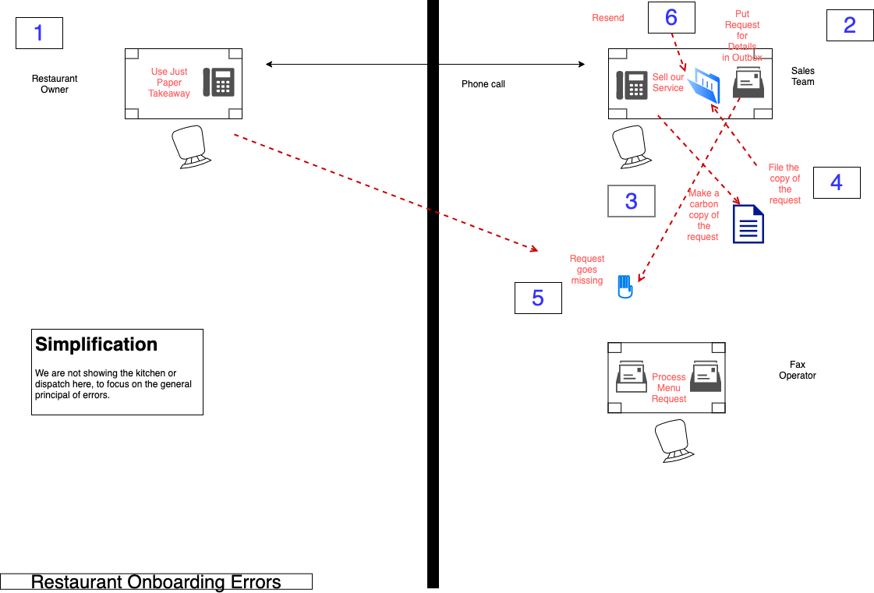

Slide 117
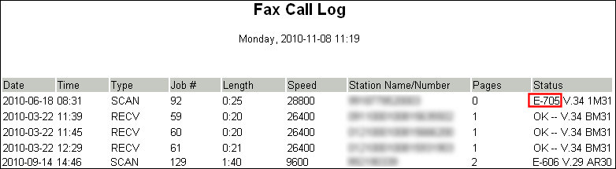
Notes:
How do we deal with errors

Slide 118
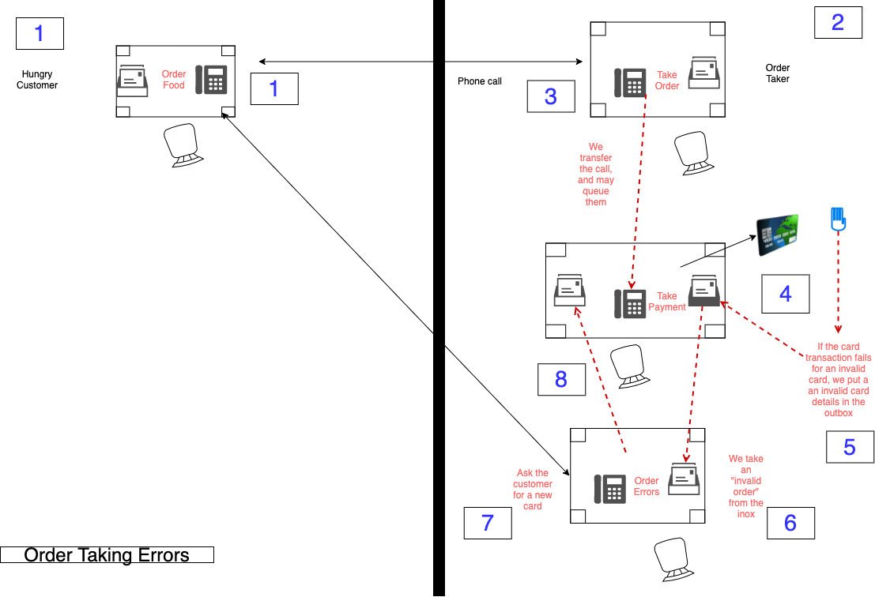

Slide 119
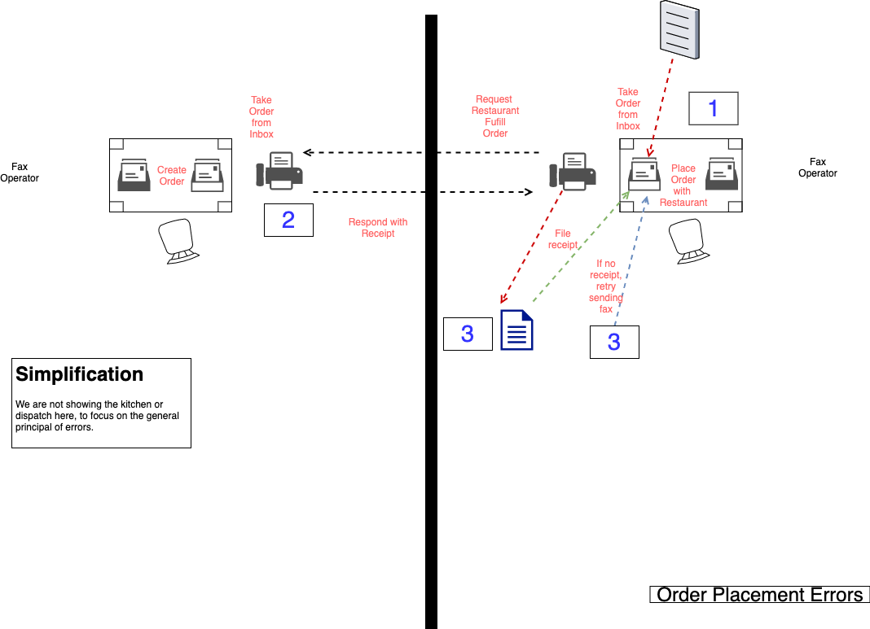

Slide 120
Flow Based Programming
“Everything Flows and Nothing Stays.” - Heraclitus

Slide 121
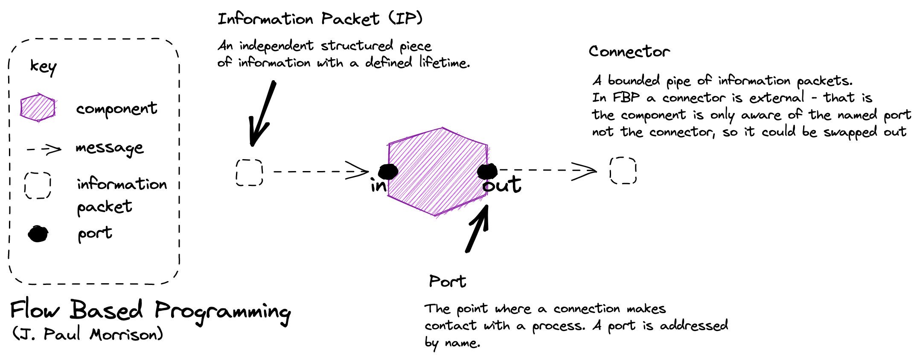
Flow-Based Programming (FBP) is a subclass of DFP. While DFP can be synchronous or asynchronous, FBP is always asynchronous. FBP allows multiple input ports, has bounded buffers and applies back pressure when buffers fill up.

Slide 122
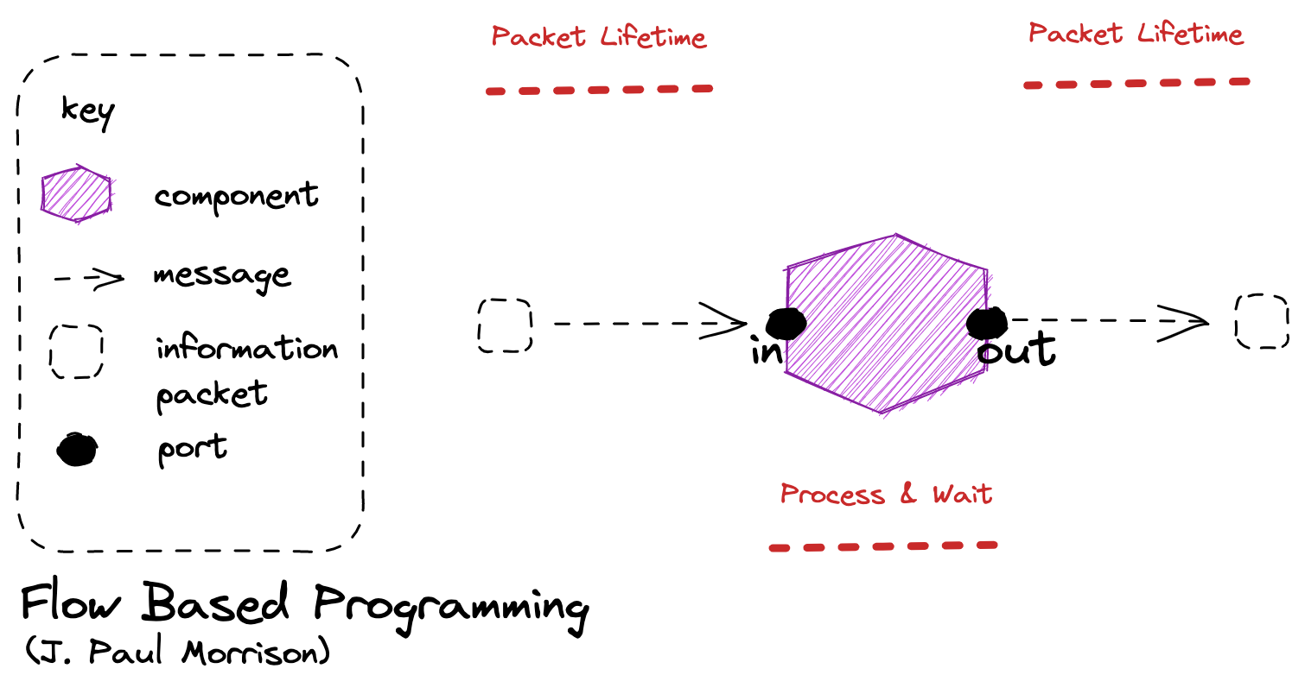
Node Lifetime: In flow base programming the a node can remain running whilst there is work on an input queue, can can suspend instead of terminate if there is no work on its connector.

Slide 123
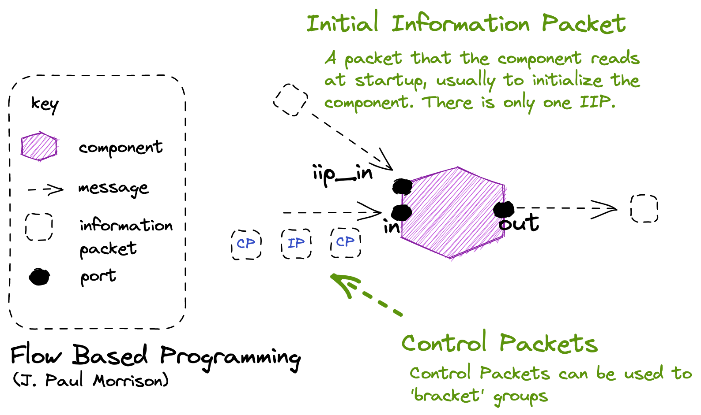
Notes:
MQTT Retained Messages are a way of emulating this IIP idea.

Slide 124
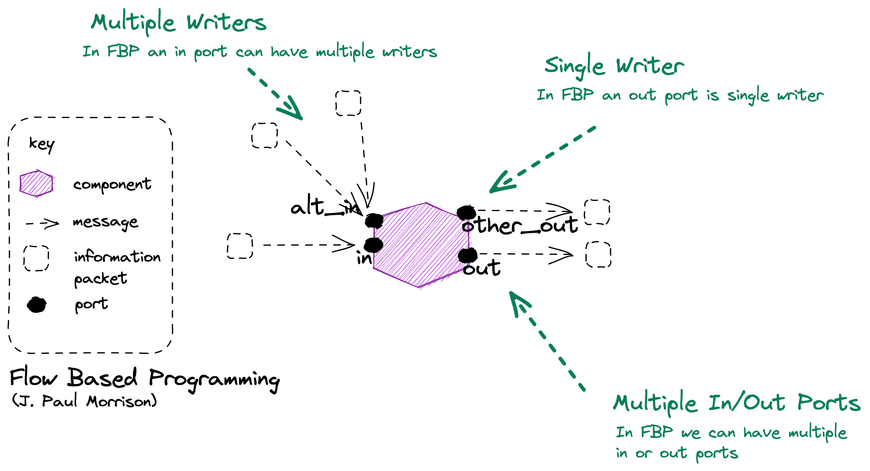
Capacity: In flow-based programming a component can test to see if it can send to out, and if not decide whether to halt or ignore.

Slide 125
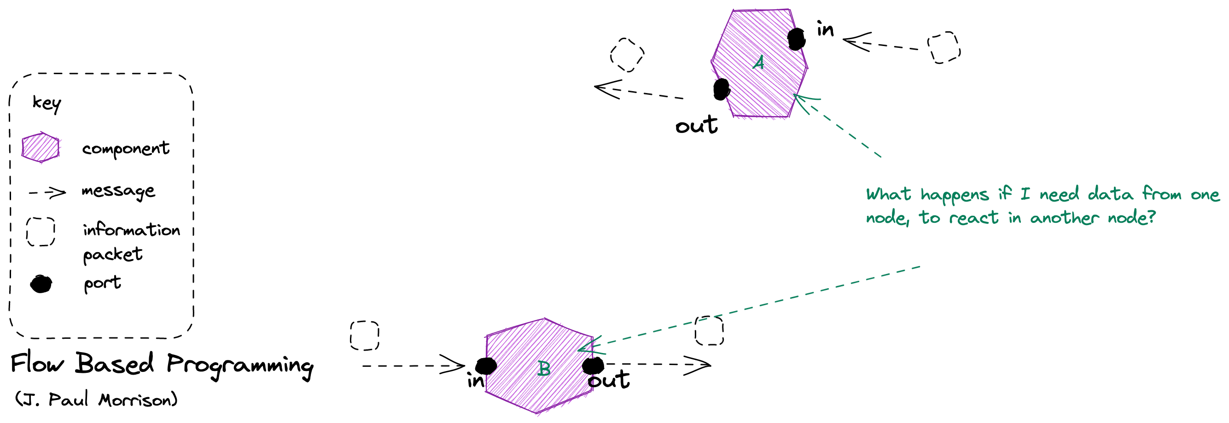

Slide 126
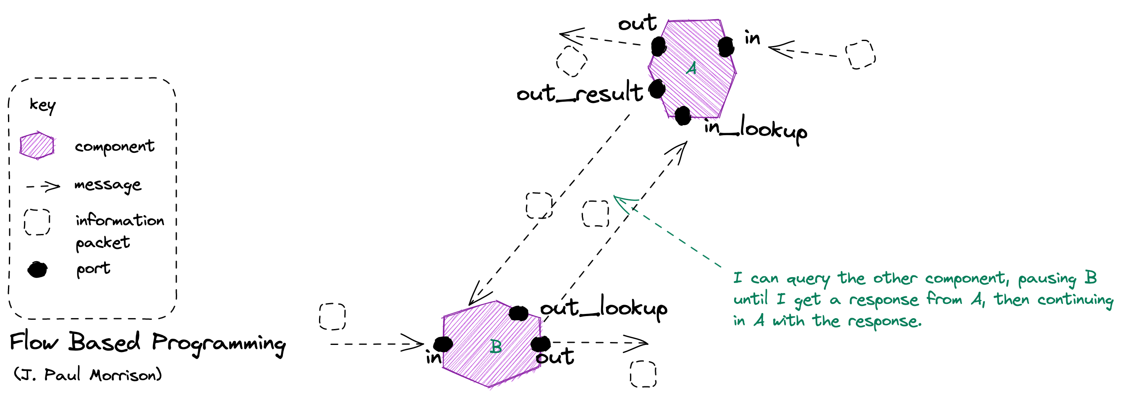
Walk of Shame: The trouble is that we may keep asking, so it makes sense to cache this somehow.

Slide 127
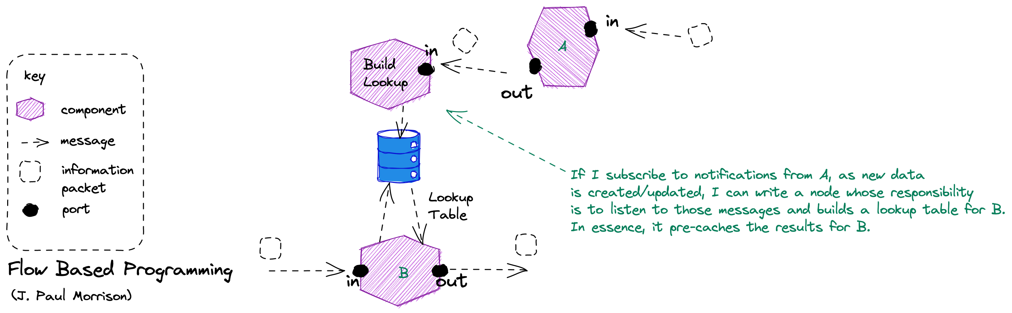

Slide 128
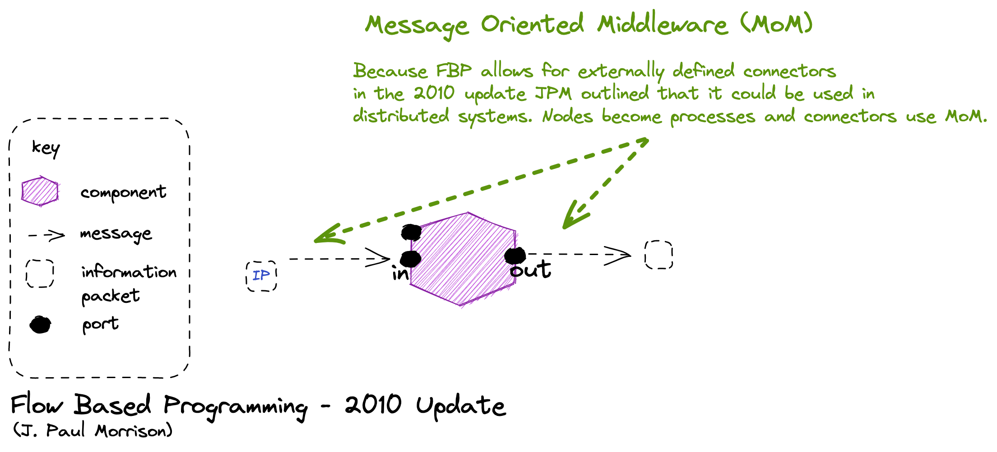

Slide 130
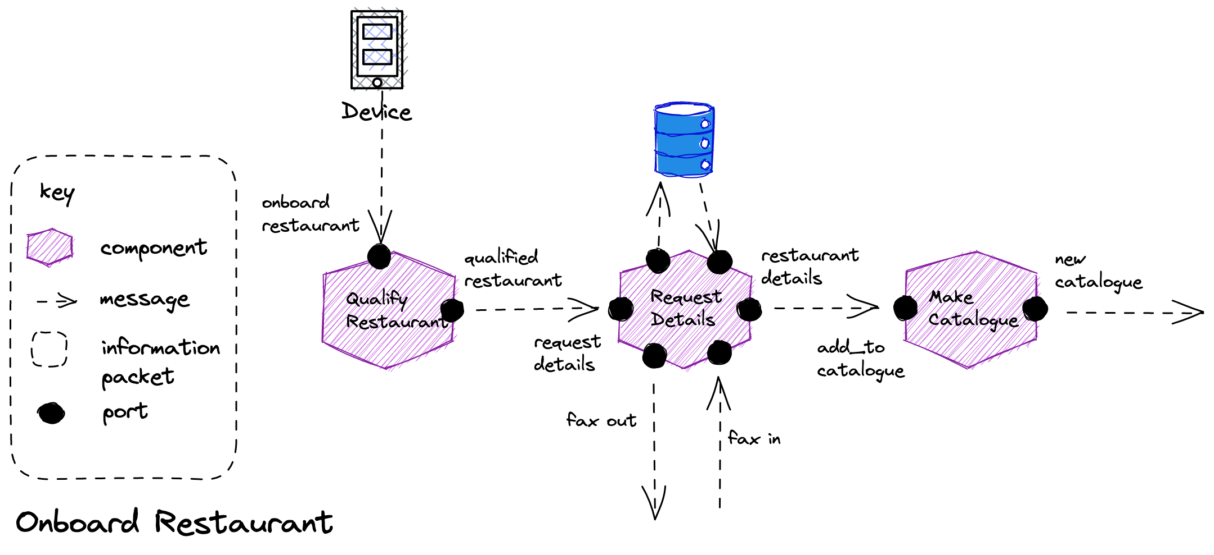
Storage: Request details may need storage to be reliable, it takes work from the request_details port, but cannot forward it to the restaurant_details port without waiting for an answer from fax_in. We store the state of the workflow in case we crash before receiving the response.
in-Only
In-Only
Out-Only
Messaging
Messaging
Eventing
Messaging
Eventing
In-Out
Correlation: To allow us to match the response to the saved state we use a correlation id. We send it on the ip to fax_out, and the restaurant includes it on the ip from fax_in. We use the ip to look up the workflow we stored.

Slide 132
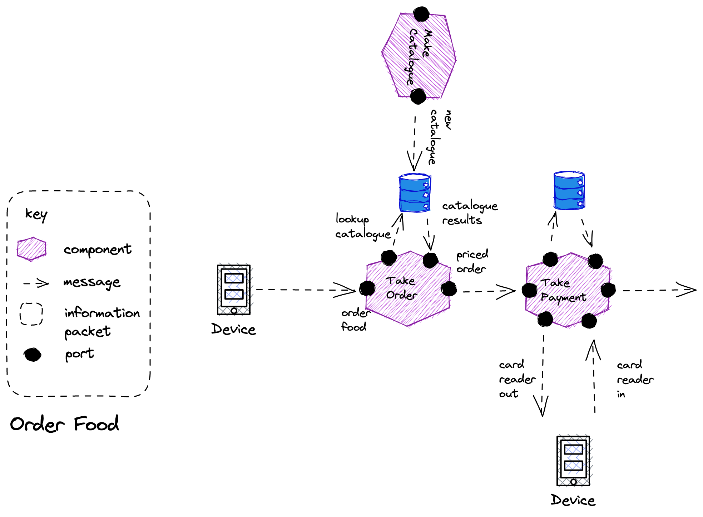
Lookup: We can build a store from IP raised from another component to act as a lookup table for information that we need to process a request.
Eventing
Out-Only
In-Only
In-Only
Messaging
Messaging
Messaging
Eventing
In-Out

Slide 134
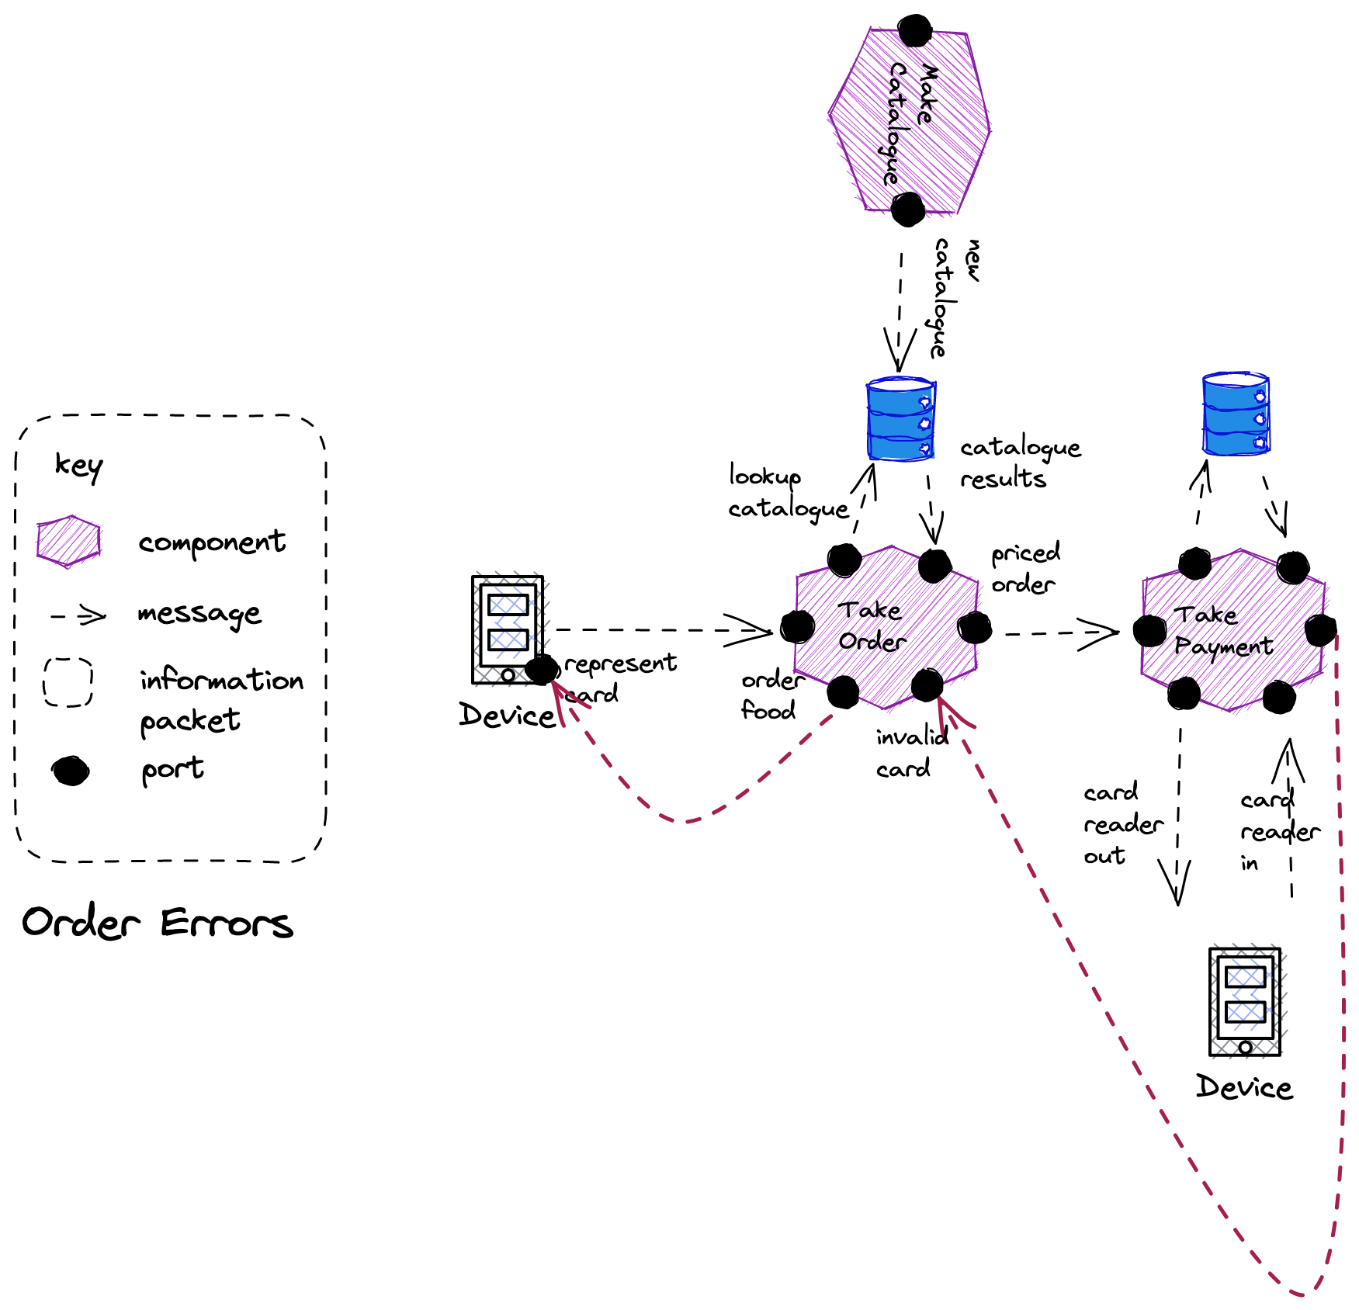
Messaging
Message Triggers
Fault
Message Triggers
Fault
Eventing

Slide 136
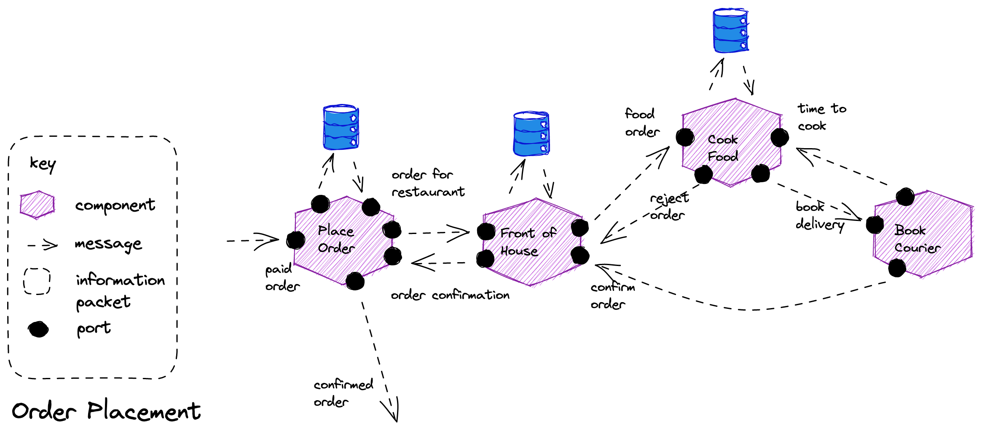
Message Triggers Fault
in-Out
in-Out
Eventing
Messaging
in-Only
Eventing
Messaging
Messaging
Messaging
in-Out
Eventing
Eventing
Eventing

Slide 138
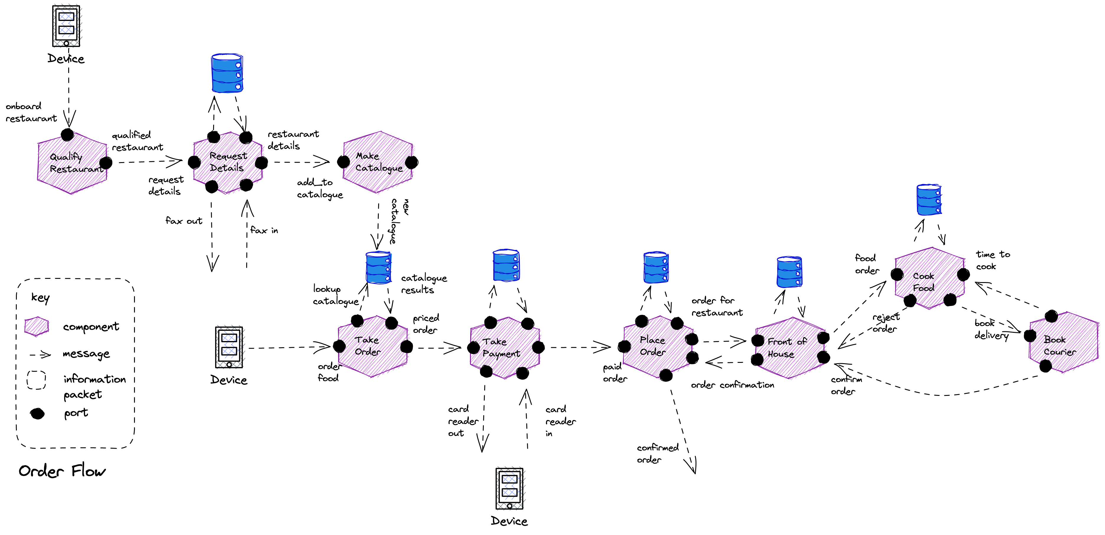

Slide 139
Exercise material
Paper Flow
Readme
Slides

Slide 140
Managing Asynchronous APIs

Slide 141
Versioning

Slide 142
Be strict when sending and tolerant when receiving. Implementations must follow specifications precisely when sending to the network, and tolerate faulty input from the network.
Robustness Principal or Postel’s Law – Jon Postel RFC 1958

Slide 143
Tolerant Reader
Account No:
Withdrawn:
Currency:
Date:
Long:
Lat:
Format: V2
Account No:
Withdrawn:
Currency:
Date:
Format: V1
Ignore New Fields
Notes:
A general rule when versioning events is that adding things does not cause a versioning conflict. Adding a new version of an event is therefore not a problem, as long as we don’t break the definition of a new version event; it must be convertible from an old version of the same event. Following these rules, when old versions are read from the store, they can first be converted, or upcasted, to the latest version before handled. This means that an event handler only needs to know how to deal with the latest version, an important benefit if many new versions have been created. To be able to convert an old version of an event when a property has been added to the new version, we use the same principle as when we add a new not nullable column to a database; we use a default value.
With Additive Changes we can process new messages on old consumers
New Consumers must default missing values from older messages
Might use Enricher.

Slide 144
Tolerant Reader
Account No:
Withdrawn:
Currency:
Date:
Long:
Lat:
Format: V2
Account No:
Withdrawn:
Currency:
Date:
Format: V1
Long: 0
Lat: 0
Default Missing Fields

Slide 145
Breaking Change
Account No:
Withdrawn:
Currency:
Date:
Format: V1
Account No:
New Balance:
Date:
Format: V2
Account.Withdrawal.Event
Account.NewBalance.Event
New Message
Notes:
With Breaking Changes we should create a new message type.
Source systems may need to send original and new, or we have to source the missing information in a Message Translator in the pipeline

Slide 146
Documentation

Slide 147
Endpoints are places where messages are sent or received (or both), and they define all the information required for the message exchange.
An endpoint describes in a standard-based way where messages should be sent, how they should be sent, and what the messages should look like.
https://docs.microsoft.com/en-us/dotnet/framework/wcf/fundamental-concepts

Slide 148


- Do I want to search all the GitHub Repos in case you documented it?
- Do I want to put a message out on Slack or Teams asking if anyone knows who exposes it?
?
Restaurant Availability
How do I know who exposes the data that I need? How do I find the endpoint that I want to consume from?

Slide 149
- Do I search all the GitHub Repos looking for the name of my message hoping to find it?
- Do I want to put a message out on Slack or Teams asking if anyone consumes it?
?
Endpoint
RestaurantHoursChanged
Restaurant Management
Who consumes the messages I send? Whom do I have a contract with?

Slide 150
Asynchronous Endpoints
Our Asynchronous APIs need documenting just like any other API (HTTP etc).
We need to document the message, because it is the contract
Endpoint
Restaurant Availability
Downstream
Restaurant Management
We need to document who sends and receives to understand flow
We need to document the channel so we know where the message is flowing
We need to document the protocol so we know how to send-receive

Slide 151
Endpoint – Documenting the Contract
An endpoint is where messages should be sent, how they should be sent, and what the messages should look like. What promises do we make.
Endpoint
An message is data that we send or receive
We will need to agree what the metadata – the headers are – and we will need to agree the encoding and schema of the body.
Message
Upstream
Metadata (Headers)
Endpoint
Data (Payload)
RestaurantHoursChanged
Channel
Downstream
Restaurant Management
A channel is the logical pipe over which messages flow. It is our address.
Binding
A binding is the details of how we implement the channel: what transport and encoding does the service support that allows messages to flow for example AMQP and Plain/Text.
In principle you can have multiple bindings for a channel.

Slide 152
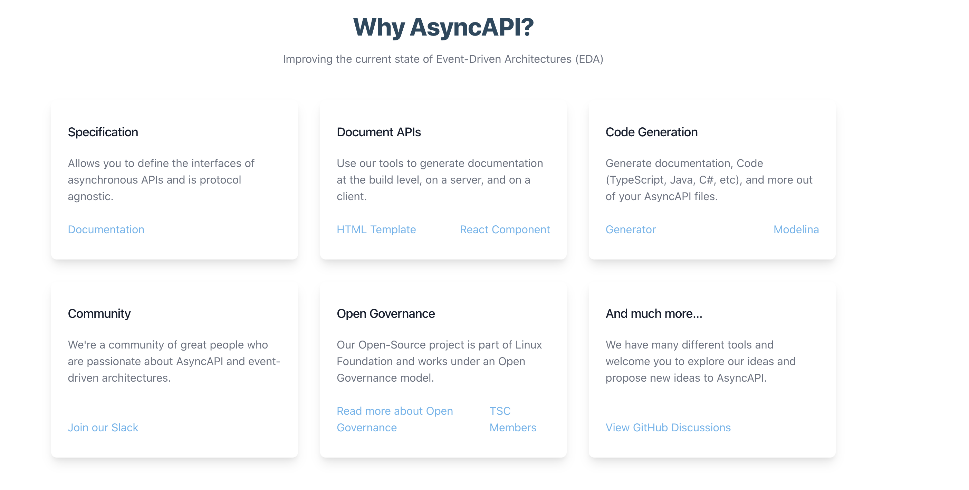

Slide 153
AsyncAPI Elements (V2)
Channels define a set of operations that clients can perform
publish, receive messages
subscribe, send messages
Channels
Application
An application is running code that acts as a producer (sends messages) or a consumer (receives messages)
Binding
Operations
Message
P
H
Binding
Bindings are protocol specific information
Messages are sent by operations
Server
A message must have a payload and can have headers. Headers may protocol or application specific.
Binding

Slide 154
Document Structure (V2)
The root object. Identifies the application being documented
AsyncAPI Object
Metadata for this specification
Info Object
Connection details for the server
Servers Object
The channels being used by the application
Channels Object
Channel item Object
The collection of operations on this channel
Operation Object
Defines an operation – publish or subscribe – made available by the application on this channel
Components Object
Re-usable components
Tags Object
User defined tags for this specification

Slide 155
AsyncAPI Elements (V3)
Operations send or receive messages over channels.
Binding
Application
Operations
Channels
Message
Binding
P
H
An application is running code that has operations:
producer (sends messages) - -
consumer (receives messages)
A message must have a payload and can have headers. Headers may protocol or application specific.
Server
Bindings are protocol specific information
Binding
A server has a protocol by which messages are exchanged.

Slide 156
Document Structure (V3)
AsyncAPI Object
The root object. Identifies the application being documented
Info Object
Metadata for this specification
Servers Object
Connection details for the server
The channels being used by the application
Channels Object
Operation Object
Defines an operation – publish or subscribe – made available by the application on this channel
Components Object
Re-usable components
Tags Object
User defined tags for this specification

Slide 157
AsyncAPI (V3) and Endpoint ABCs
AsyncAPI Object
Endpoint
Info Object
Message
Servers Object
Metadata (Headers)
Channels Object
Data (Payload)
Channel
Operation Object
Binding
Components Object
Tags Object

Slide 158
AsyncAPI Object
id: https://github.com/brightercommand/greetings/
We use a specification file for an app, which is a producer or consumer, and identify them by id

Slide 159
Info Object
info:
contact:
name: Paramore Brighter
url: https://goparamore.io/support
email: support@goparamore.io
license:
name: Apache 2.0
url: https://www.apache.org/licenses/LICENSE-2.0.html
description: Demonstrates sending a greeting over a messaging transport.
title: Brighter Sample App
version: 1.0.0
tags:
- name: brighter examples

Slide 160
Servers Object
development:
description: A Kafka broker for local development
url: localhost:9092
protocol: kafka

Slide 161
Channels (V2)
greeting:
subscribe:
operationid: sendGreeting
summary: sends a greeting
description: This service lets you send the ‘Hello World’ greeting to another service.
message:
$ref: "#/components/messages/greeting”
bindings:
kafka:
partitions: 20
replicas: 3

Slide 162
Channels (V3)
greeting:
address: ‘goparamore.io.greeting’
summary: For sending greetings
description: This channel contains greeting messages
servers:
- $ref: '#/servers/development’
messages:
greeting:
$ref: "#/components/messages/greeting”
bindings:
kafka:
partitions: 20
replicas: 3

Slide 163
Operations (V3)
sendGreeting :
action: send
summary: sends a greeting
description: The application sends a greeting to a consumer.
channel:
$ref: "#/channels/greeting”
bindings:
kafka:
partitions: 20
replicas: 3

Slide 164
Components
components:
messages:
greeting:
name: greeting
title: A salutation
summary: This is how we send you a salutation
contentType: application/json
traits:
- $ref: '#/components/messageTraits/commonHeaders'
payload:
$ref: "#/components/schemas/greetingContent"
schemas:
greetingContent:
type: object
properties:
greeting:
type: string
description: The salutation you want to send
…

Slide 165
JSON Schema (AsyncAPI Schema Object)
$schema
{
”$schema” : "https://json-schema.org/draft/2020-12/schema",
“$id” : “https://goparamore.io/greeting.schema.json”,
“title” : “greeting”,
“description” : “A greeting message”,
“type” : “object”,
“properties” : {
“greeting” : {
“description” : “the salutation”
“type” : string
}
}
}
$id
title
description
type
properties

Slide 166
Avro
Complex Types:
records
enums
arrays
maps
unions
fixed
Records:
name
namespace
doc
alias
fields
name
doc
type
default

Slide 167
Avro
{
“type” : “record”,
“name” : “greeting,”
“title” : “greeting”,
“fields” : [
{“name” : “greeting”, “type” : “string”}
]
}

Slide 168
Avro
Encodings:
JSON
Languages:
C
Binary
C++
C#
Java
Perl
Python
Ruby
Others…

Slide 169
Protobuf
syntax = "proto3";
message Greeting {
string greeting = 1;
}

Slide 170
Protobuf
Encodings:
Binary
Languages:
C++
C#
Dart
Go
Kotlin
Java
Objective-C
Python
Ruby
Others…

Slide 171
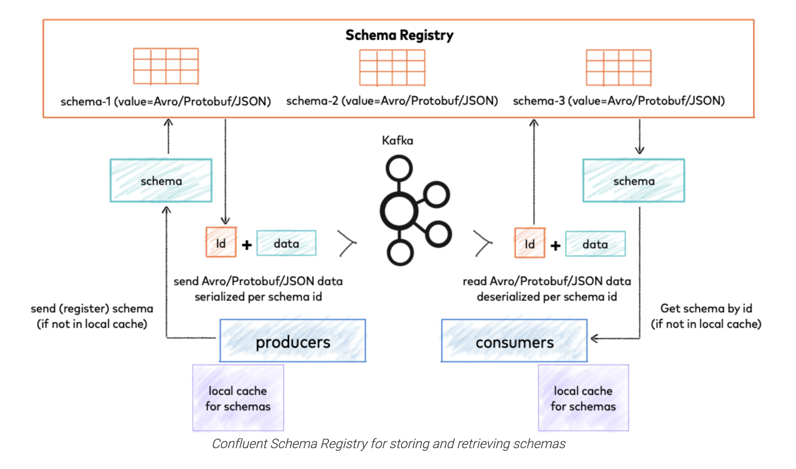
Schema Registry
https://docs.confluent.io/platform/current/schema-registry/index.html

Slide 172
Cloud Events
Id - unique identifier
Unique
source - production context
Required Attributes
specversion - CE version
Event
type - name + version
Metadata
Optional Attributes
Payload
datacontenttype - MIME type
dataschema - URI of payload schema
subject – qualifies source
Data
time – timestamp (Internet)

Slide 173
Protocol Binding
Binding Type
amqp 1-0
avro
Binary
http
Uses the protocol’s native approach to metadata
http-webhooks
CloudEvent
kafka
mqtt
Structured
nats
Adds headers to the payload (envelope)
protobuf
websockets

Slide 174
Protocol Binding
Binary
Structured
------------------ Message -------------------
Topic Name: mytopic
------------------- key ----------------------
Key: mykey
------------------ headers ------------------- ce_specversion: "1.0"
ce_type: "com.example.someevent"
ce_source: "/mycontext/subcontext"
ce_id: "1234-1234-1234"
ce_time: "2018-04-05T03:56:24Z"
content-type: application/avro
------------------- value --------------------
... application data encoded in Avro ...
-----------------------------------------------
------------------ Message -------------------
Topic Name: mytopic
------------------- key ----------------------
Key: mykey
------------------ headers -------------------
content-type: application/cloudevents+json; charset=UTF-8
------------------- value --------------------
{
"specversion" : "1.0",
"type" : "com.example.someevent",
"source" : "/mycontext/subcontext",
"id" : "1234-1234-1234",
"time" : "2018-04-05T03:56:24Z",
"datacontenttype" : "application/json",
"data" : {
... application data encoded in JSON ...
}
}
-----------------------------------------------

Slide 175
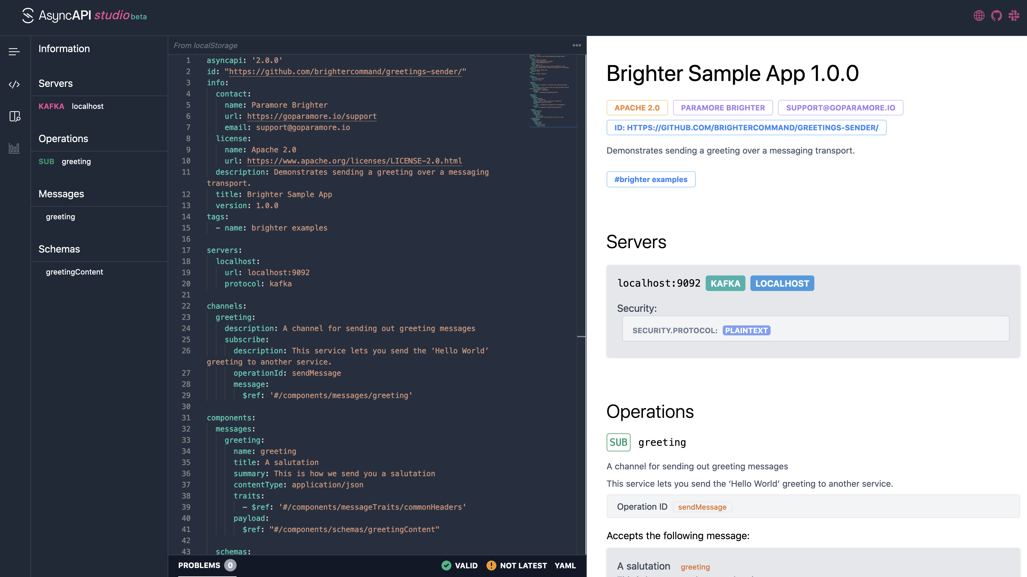
AsyncAPI Studio

Slide 176
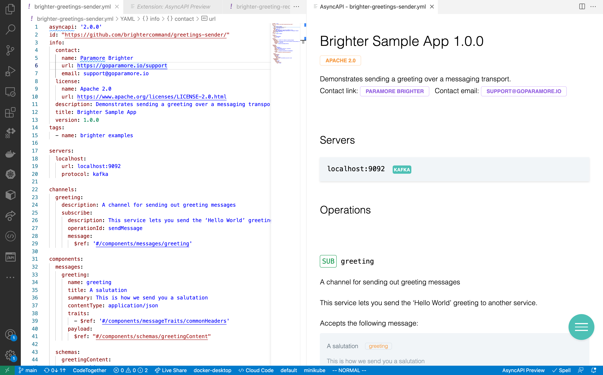
VS Code

Slide 177
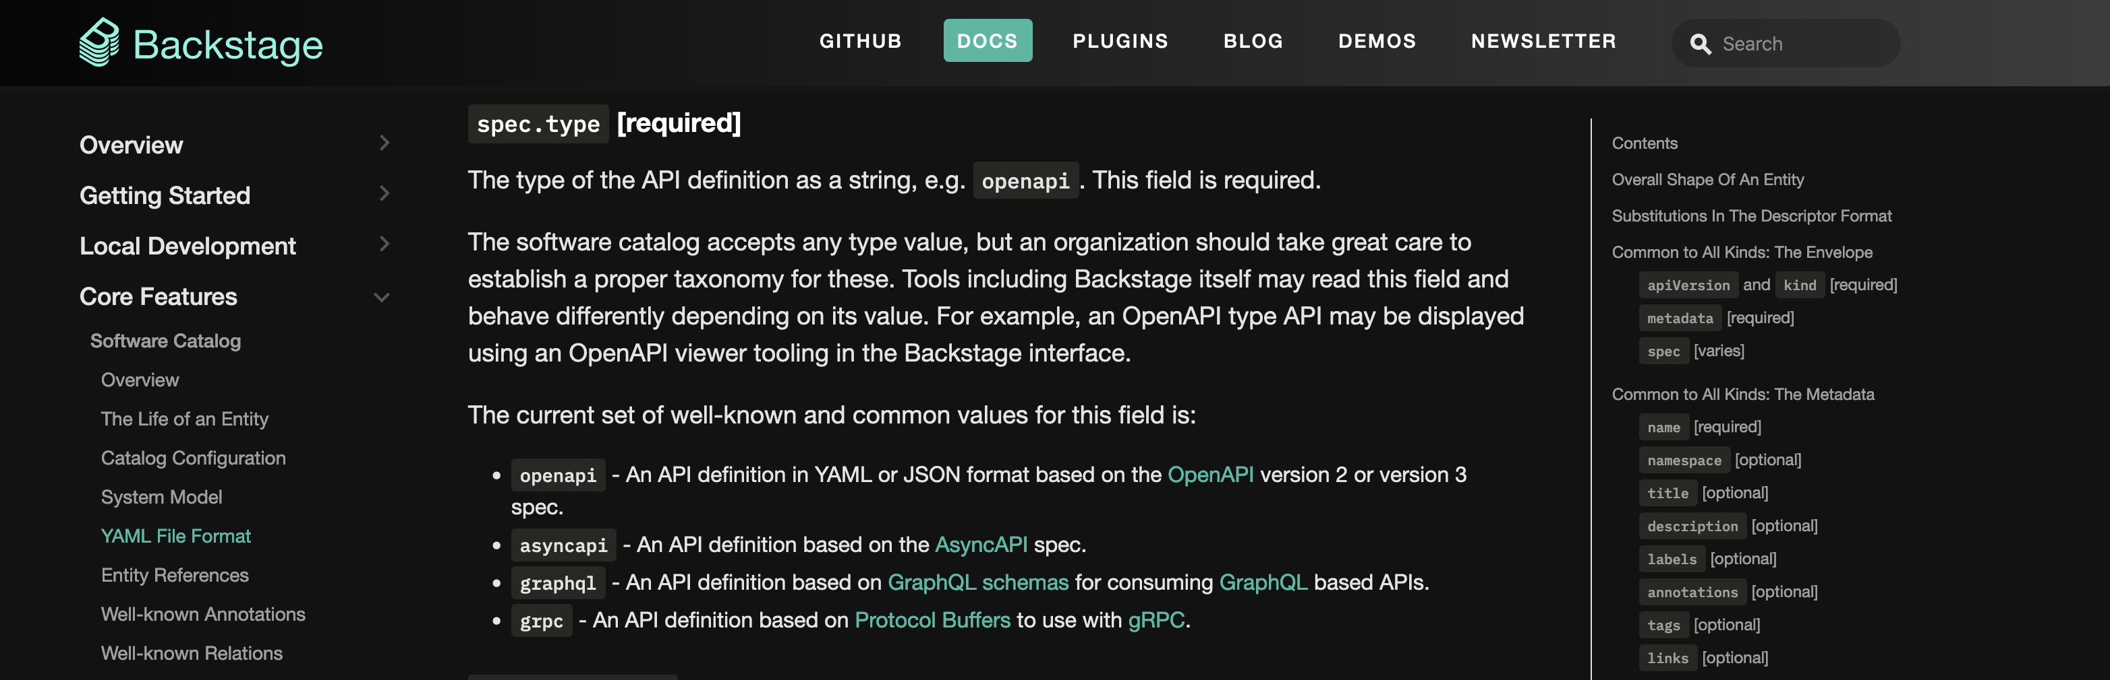
Backstage

Slide 178
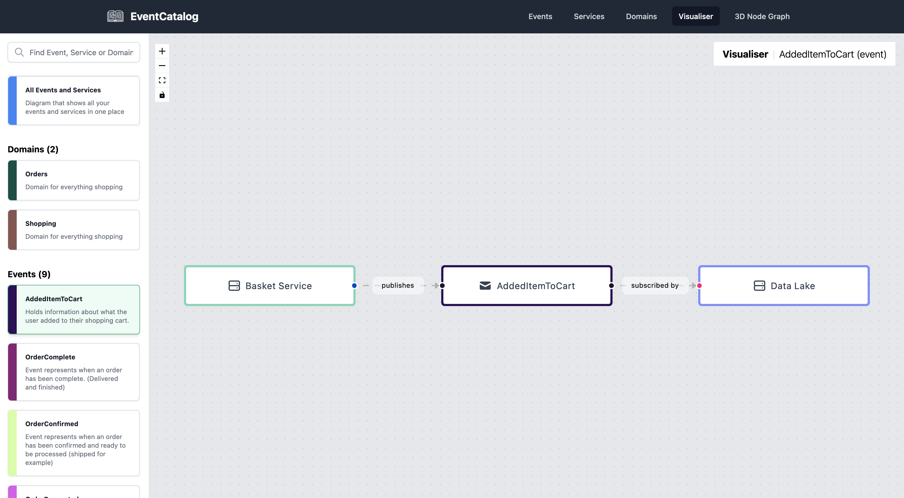
Event Catalog
https://github.com/boyney123/eventcatalog

Slide 179
Observability

Slide 180
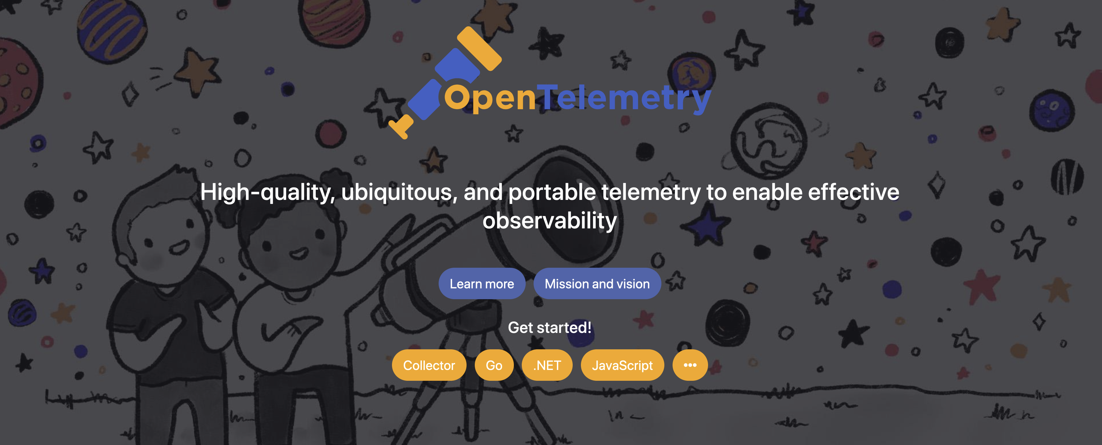

Slide 181
OpenTelemetry Tracing
Endpoint
Restaurant Availability
Downstream
Restaurant Management
We serialize the span context into the headers of the message when we send it
We begin a span when initiate a flow.
We begin a child span in the receiver

Slide 182
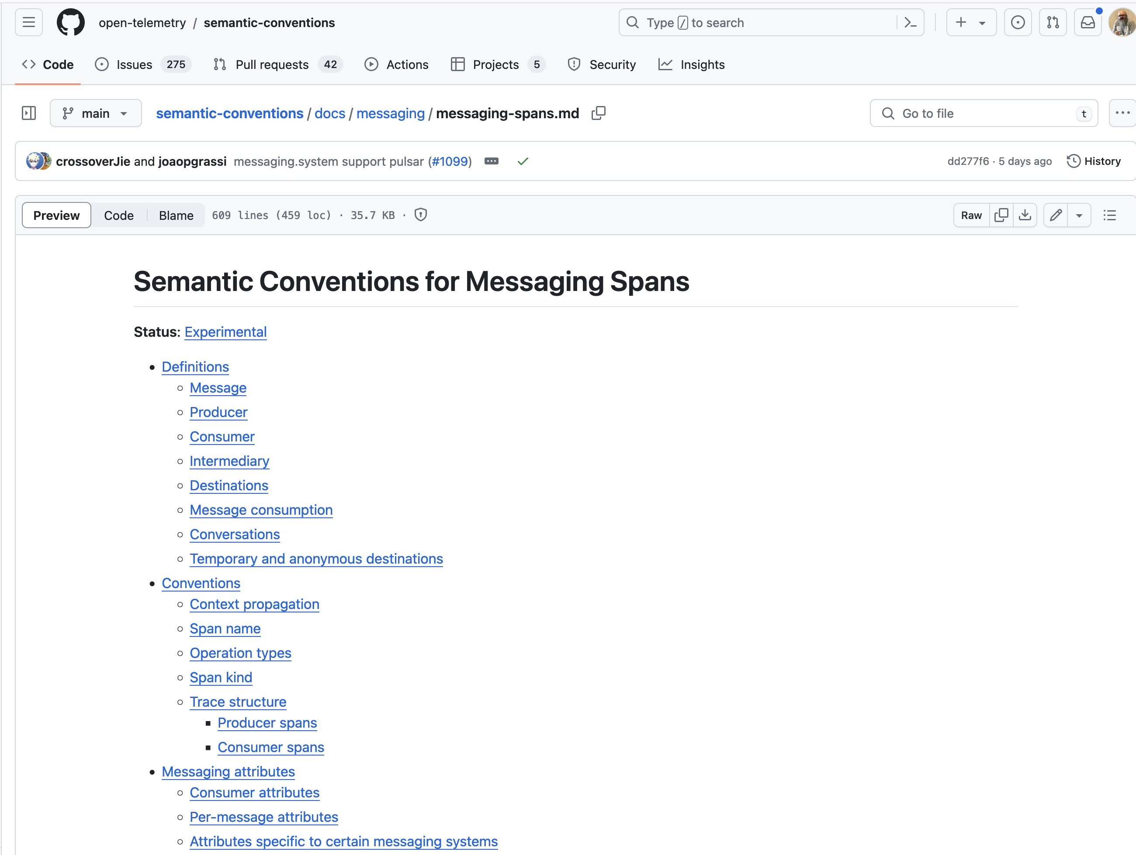
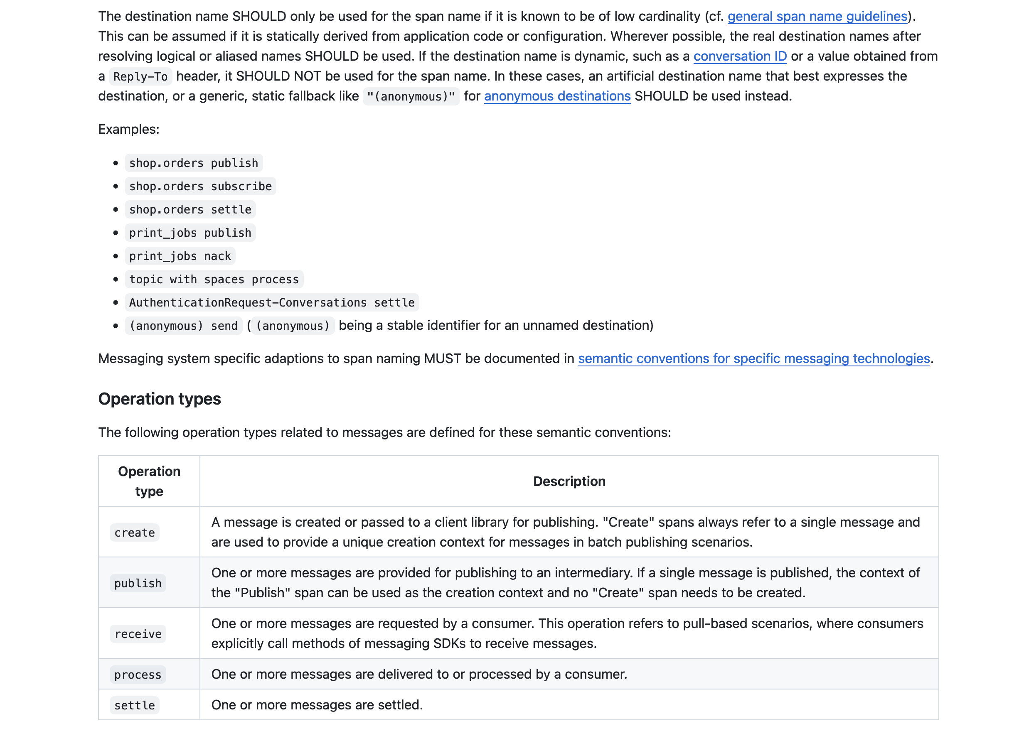

Slide 183
Next Steps

Slide 184

Further Reading

Slide 185

Further Reading
https://serverlessland.com/event-driven-architecture/visuals

Slide 186
Q&A

